Slide 1

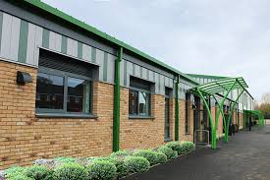

Slide 2

Our vision…
Shrivenham School gives everyone the opportunity to believe in themselves, others, and God. Through our values of love, hope and courage, everyone at our school will flourish, fulfil their unique potential and positively contribute to the community.

Slide 3

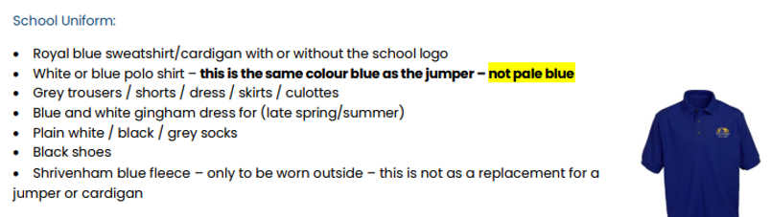
Uniform
We would like every child to have a waterproof coat and wellies in school, so we are able to go out in all weather! Please bring these in asap – we have wellie stores for each class outside. Coats can be taken to and from school or kept on their pegs.
Winter:
Scarf, hat gloves and a warm coat.
Summer:
Sun cream applied at home, summer hat and a water bottle!

Slide 4
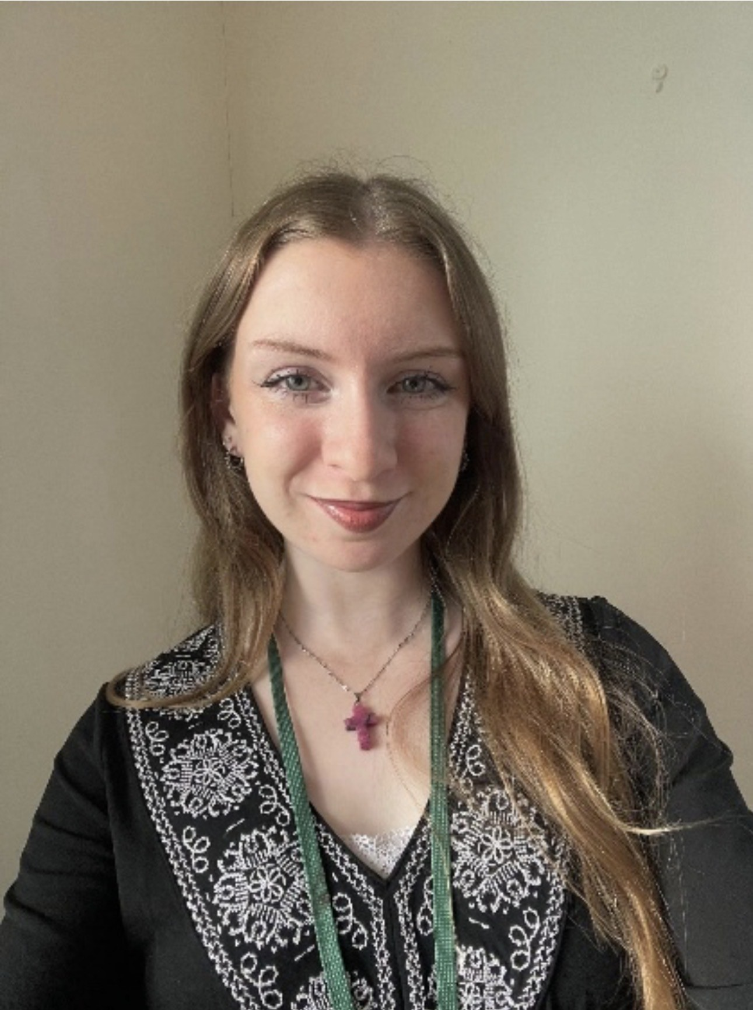
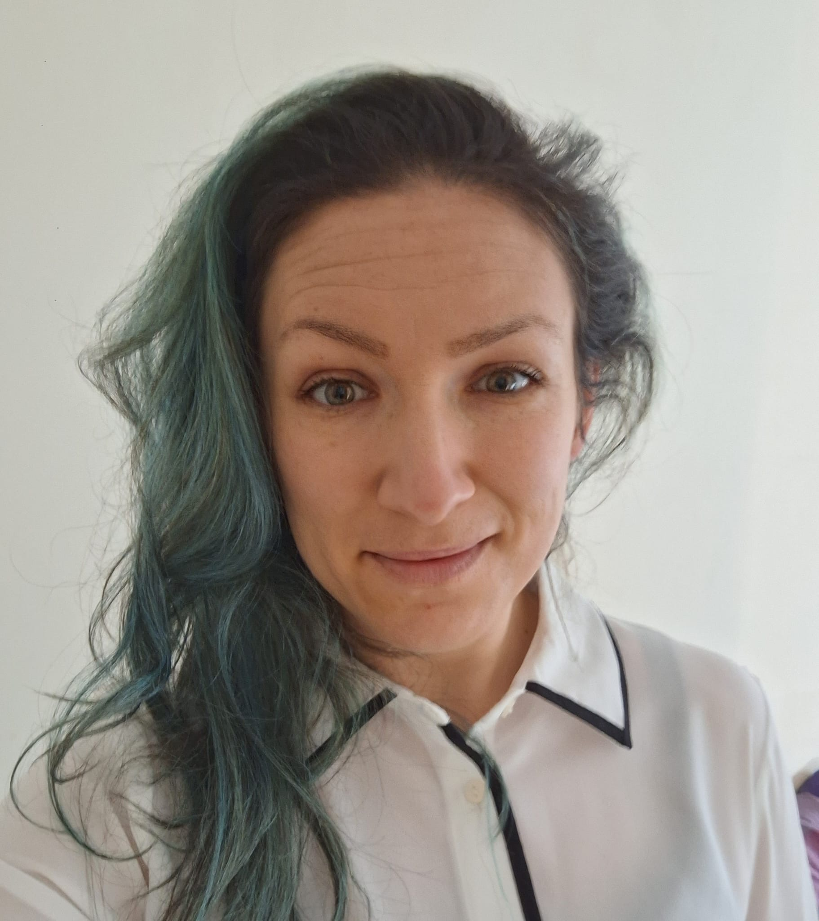
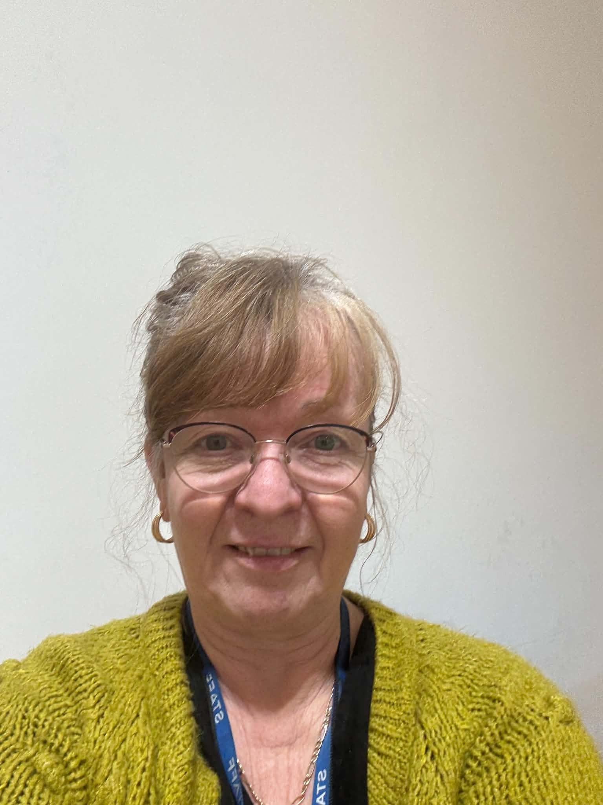
Welcome to our school
Adults in Walnut Class
Mrs Brown
Teaching Assistant
(every morning)
Mrs Trafford
Teaching Assistant
(Tue/Weds morning)
Mrs Dunford
HLTA
(Friday teacher)
Miss Roe
Class Teacher

Slide 5
What does a day in Walnut class look like?
8:30 - Arrive at school
8:40 - Register and lunch choices
8:45 – Reading
9:30 – Maths
10.15 – Break time
10:30 - English
11:30 - Maths MOT
11:45 – Spelling / Handwriting
12:00 - Lunch
1:00 - Collective worship
1:20 - Curriculum
2:00 - Curriculum
3:00 - Home

Slide 6
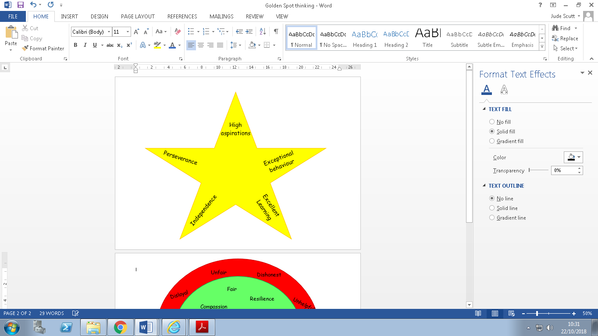

Expectations
At school, it is expected that children will behave well all of the time – not only during learning time in the classroom, but at playtime, lunchtime, moving around school and during extra-curricular activities. Children are taught to understand that they should behave respectfully to each-other and to all adults.
We want our children to take personal responsibility for the choices they make and understand the consequences for their choices including the impact it has on themselves as well as others. We spend time demonstrating and discussing this through daily teaching and weekly PSHE lessons.
A copy of our new Relational Policy can be found on the school website and will be emailed to all parents.

Slide 7
Curriculum
Details about the curriculum for each subject can be found on the school website.
This year, the enquiry topics for Walnut class will be:
Term 1&2 –Raiders and Invaders (Anglo-Saxons and Vikings)
Term 3&4 –Mighty Mayans (Ancient Mayan Civilization)
Term 5&6 –Rivers: From Source to Sea (river formation and a study of the River Danube compared to The River Thames)
An overview for each term will be posted on the class webpage.

Slide 8
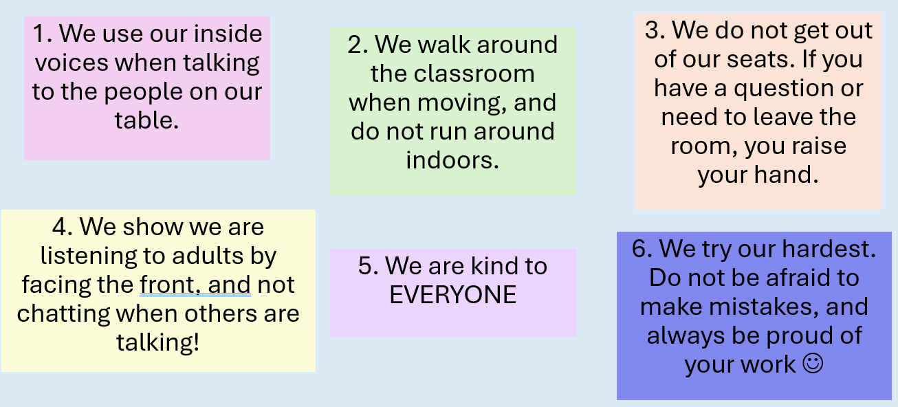
Our expectations in Year 5
We will be sending home a booklet of Key Performance Indicators – which are key areas children need to achieve by the end of the year. More information on this will be coming.

Slide 9
Parents’ Evenings
Why change in the date?
We would like to meet you in January and April, after we have completed our termly teacher assessments.
What do we talk about?
We will talk about your child’s progress towards their end of year target.
It is an opportunity for you to ask questions as well
If you have any concerns in between the Parents’ Evening, you are always welcome to speak to us as class teachers.
We have open classrooms this term – come and see your child’s classroom.

Slide 10



Homework
This year, there continues to be an emphasis on reading and times tables for homework. Children are expected to read 5 x a week at home and to practise their number bonds and times tables using Numbots and Times Tables Rock Stars at least 3 x per week. Logins have been sent home.
Children will also need to learn their weekly spellings. The term’s spellings will be handed out at the beginning of each term and will also be available on the class page on the school website.

Slide 11
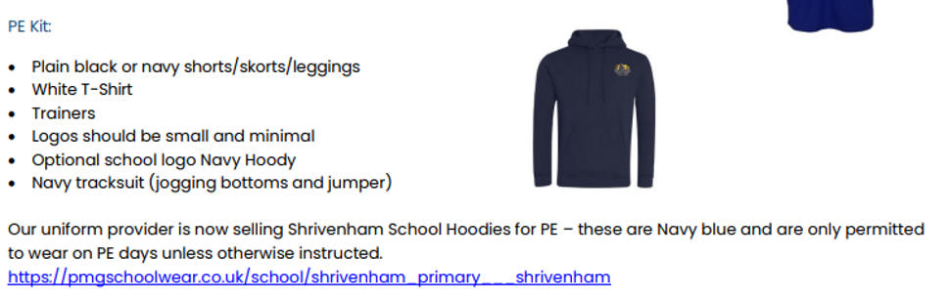

PE
Children will have two PE lessons every week (Wednesday and Thursday). Children must come to school wearing their PE kit on these days.
When the weather allows, this will be outside so please ensure, the children have warm layers as it gets colder. Only in extreme or unsafe weather will stop the PE!

Slide 12

Attendance/Absence
Attendance at school is vitally important to ensure the children make the most of their education and social development. We have a school target of 96% attendance across the year and we monitor this very closely.
Absence
If your child is going to be absent from school, you have to ensure you have made contact with the school office before 9am. This can be by email or telephone.
If we do not hear from a family, we will follow this up as it is our duty to safeguard every child.
We understand that sometimes children are poorly or medical appointments can’t be avoided during the school day but where possible we would ask that routine/general appointments are made outside of the school day.
We monitor attendance on a termly basis and send letters to parents where attendance is a concern. This is a supportive approach and we will always listen and offer advice and support where possible.

Slide 13

SEN and Pastoral support
As a school, we take pastoral care and wellbeing very seriously and it is at the forefront of our school’s vision of leading a mentally healthy school so that 'all things are possible'.
Mrs Forrester is our Pastoral Assistant for the school. She works 5 days per week and liaises with all class teachers and teaching assistants regarding the well-being of the children on a day to day basis.
As a school we believe and value each of our children as unique and individual, we believe that they all flourish in their own time with the right support and nurture. Children who are identified to have additional needs are supported to allow them to reach their full potential.
Mrs Keizer our Special Educational Needs Coordinator and can be contacted for any concerns or support you may have. She works closely with staff and external agencies to support pupils who need extra help to achieve their full potential at school.

Slide 14
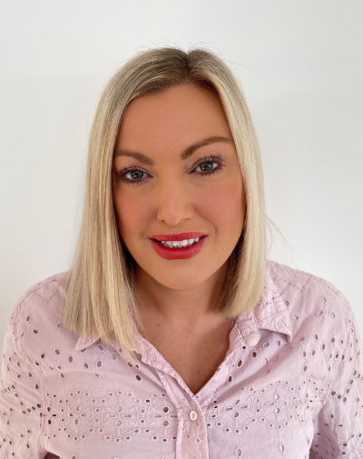
Home School Link Worker
We know that a strong connection between home and school is key to every child's success. That's why we're proud to have a dedicated Home School Link Worker (HSLW) as part of our team.
Our HSLW is here to support not just children, but families too. Whether you're facing challenges at home, need help navigating school processes, or just want someone to talk to, our HSLW is a friendly and understanding point of contact. They work closely with parents and carers to help ensure every child feels safe, supported, and ready to learn.
Some of the ways our HSLW can help include:
Offering advice and support with parenting, routines, and behaviour
Connecting families with local services and resources
Supporting attendance and helping overcome barriers to learning
Helping families through times of change or difficulty (e.g., bereavement, family breakdown)
Building positive relationships between home and school
They are available for informal chats, one-to-one support, or just a listening ear when needed.
Our HSLW is here to make sure no family feels alone – we are all part of the same team, working together for our children’s well-being and success.
If you'd like to find out more or get in touch with our Home School Link Worker, please contact the school office.

Slide 15
How do we communicate with parents?
Website
    Curriculum
    Important information such as term dates, uniform, support (SEN, pastoral etc)
Updates through ParentPay
Class pages on the website
    Topic overviews
Class Dojo
www.shrivenhamschool.co.uk

Slide 16
Contact details:
Office email:
office@shr.cambrianlt.org

