Slide 1

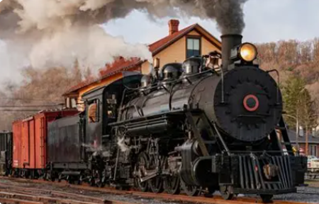
English
Writing a first person narrative and character description based on 'The Arrival.'
Writing a balanced argument and a letter based on 'Last.'
Consolidating and developing our grammar skills including: parenthesis, speech, passive voice and conjunctions.
Developing our handwriting and presentation skills to ensure that we feel proud of our work.
Year: 6
Term: Autumn
Topic: Steam
Mathematics
Using White Rose Maths:
Number—Place Value
Addition and Subtraction
Decimals
Multiplication and division
Fractions
Shrivenham C of E Primary School
Personal, Social and Emotional
Development/PSHE
Dealing with friendship problems.
Assertiveness
Developing our confidence
Dealing with conflict
RE
Looking at different pilgrimages, then focussing on Hindu pilgrimages and how they are significant to Hindus. We then move on to looking at how Christians try to make the world a better place.
Science
Animals including humans – circulation.
Living things and their habitats classification.
History
Using a timeline to understand what life was like before and during the Industrial Revolution.
Understanding what a steam engine is and how this developed machinery and transport.
Researching the life of an 11 year old during the time of the Industrial Revolution and what conditions were like for them.
Considering the wider impact on society for the development of steam transportation.
Art
Using inspiration from the artist Megan Coyle to complete a piece of collage themed around our 'Steam' topic.
Music
Considering music in film. Looking at how the tempo, pulse and volume can impact on a story.
Physical Development/PE
Hockey
Team games
Spanish
Our 'This is Me' topic helps us to describe ourselves and others.

