Slide 1

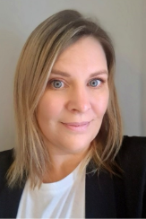
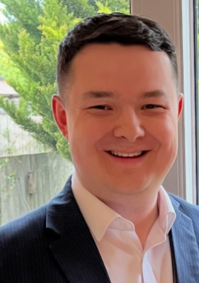
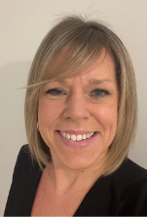
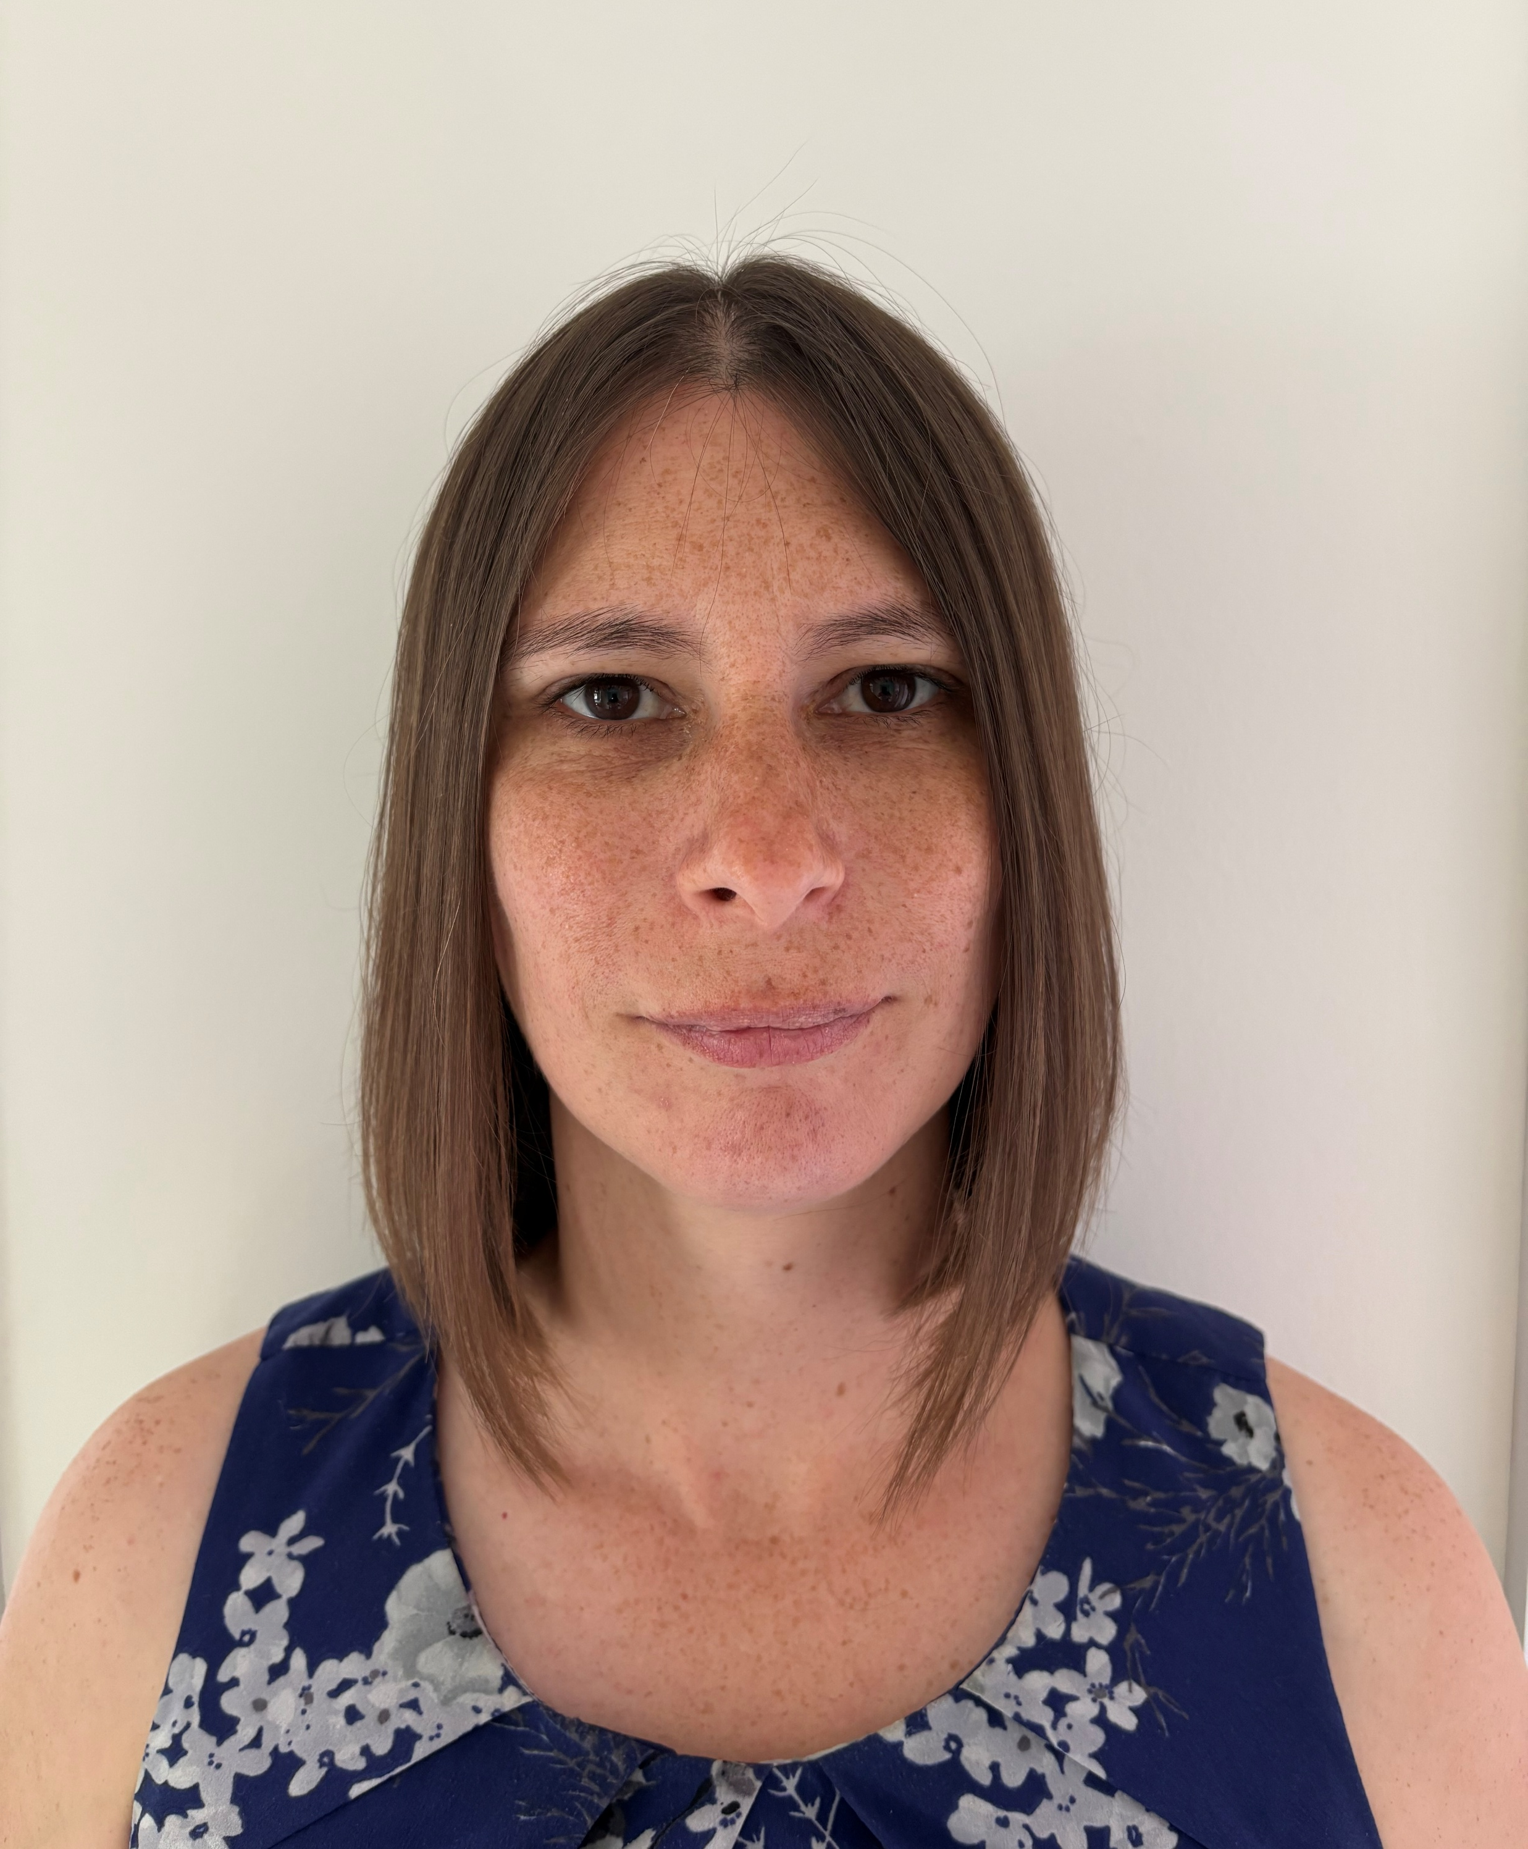

Welcome to Shrivenham CE Primary School
Mrs Scutt Executive Headteacher
Mrs Williams Head of School | Mr Robins Deputy Head | Mrs Keizer SENDCo | Mrs Kearns EYFS Leader

Slide 2
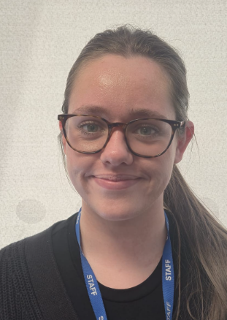
Mrs Kearns Willow Class | Miss Reece Cherry Class

Slide 3
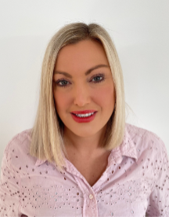
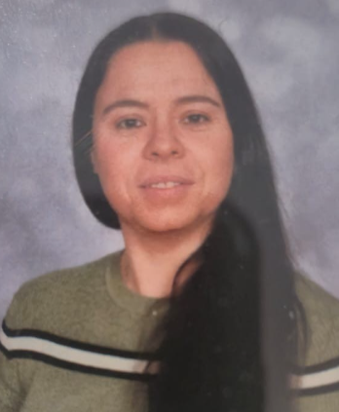
Admin and Pastoral Support
Mrs Cooper-Taylor | Mrs Forrester
Home School Link Worker | Pastoral Assistant

Slide 4
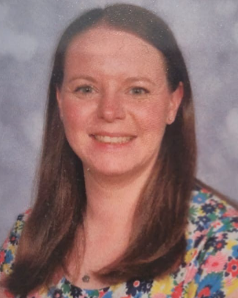
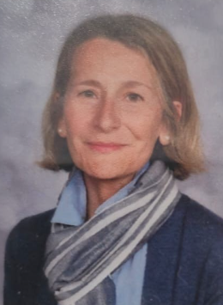
Mrs Bradley | Mrs Roe | Mrs King – Evans
Our office team

Slide 5







Values
Vision
What helps us to achieve our vision and values?

Slide 6

EYFS Vision

Slide 7
Key Principles
Language rich environment
Learn through play
High quality books
Strong relations
Free flow

Slide 8
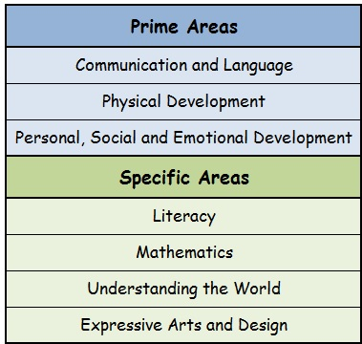
EYFS FRAMEWORK
Prime Areas

Slide 9
Communication and language | Physical Development | Personal, social and emotional Development
Engage in story times. Articulate their ideas and thoughts in well-formed sentences. Ask questions. Listen carefully and why listening is important. Listen to and talk about stories. Listen to and talk about non-fiction. Build new vocabulary. | Know and talk their overall health and wellbeing. Develop the foundations of handwriting. Further develop a range of ball skills including: throwing, catching, kicking, passing, batting and aiming. Combine different movements with ease and fluency. | See themselves as a valuable individual. Build constructive and respectful relationships. Show resilience and perseverance in the face of challenge. Identify and moderate their own feelings socially and emotionally. Show resilience and perseverance in the face of challenge. Manage their own needs.

Slide 10
Literacy | Mathematics | Understanding the World | Expressive Arts and Design
Read individual letters by saying the sounds for them. Blend sounds into words. Form lower-case and capital letters correctly. Write short sentences. Read a few common exception words. | Link the number symbol (numeral) with its cardinal number value. Subitise. Explore the composition of numbers to 10. Understand the ‘one more than/one less than’. Automatically recall number bonds for numbers 0–10. Select, rotate and manipulate shapes. Compare length, weight and capacity. | Talk about the past. Draw information from a simple map Recognise some similarities and differences between countries. Understand that some places are special to members of their community. Talk about the differences between materials and changes they notice. | Explore and a variety of artistic effects. Return to and build on their previous learning. Create collaboratively sharing ideas, resources and skills. Sing in a group or on their own. Develop storylines in their pretend play.

Slide 11
A typical day
Our School Day
Breakfast club is available from 7.30am. Cost £6
School starts 8.30am
Across the day, the children will have lots of time for free play and do some adult led tasks, such as phonics and maths.
Lunch
Hot dinners or packed lunch
School finishes 3.00 pm
After school club is available until 5.45pm Cost £11.50/£13.50

Slide 12
In the Classroom
Child Initiated
Small Groups
Tutor Table
Whole Class

Slide 13

Important Dates

Slide 14






.

Slide 15

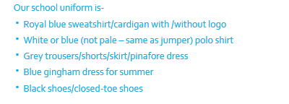
What your child needs
Coat / Hat / Scarf / Gloves
Sun hat / sunglasses
Puddle suit
Wellies
PLEASE MAKE SURE EVERYTHING IS NAME

Slide 16
Communication
Face to face – every morning and afterschool
Website – curriculum, dates, policies
Newsletter – start of the term and mid-way/end of a term
Updates through Parent Pay
Class Dojo – every Monday class updates and other information when appropriate

Slide 17
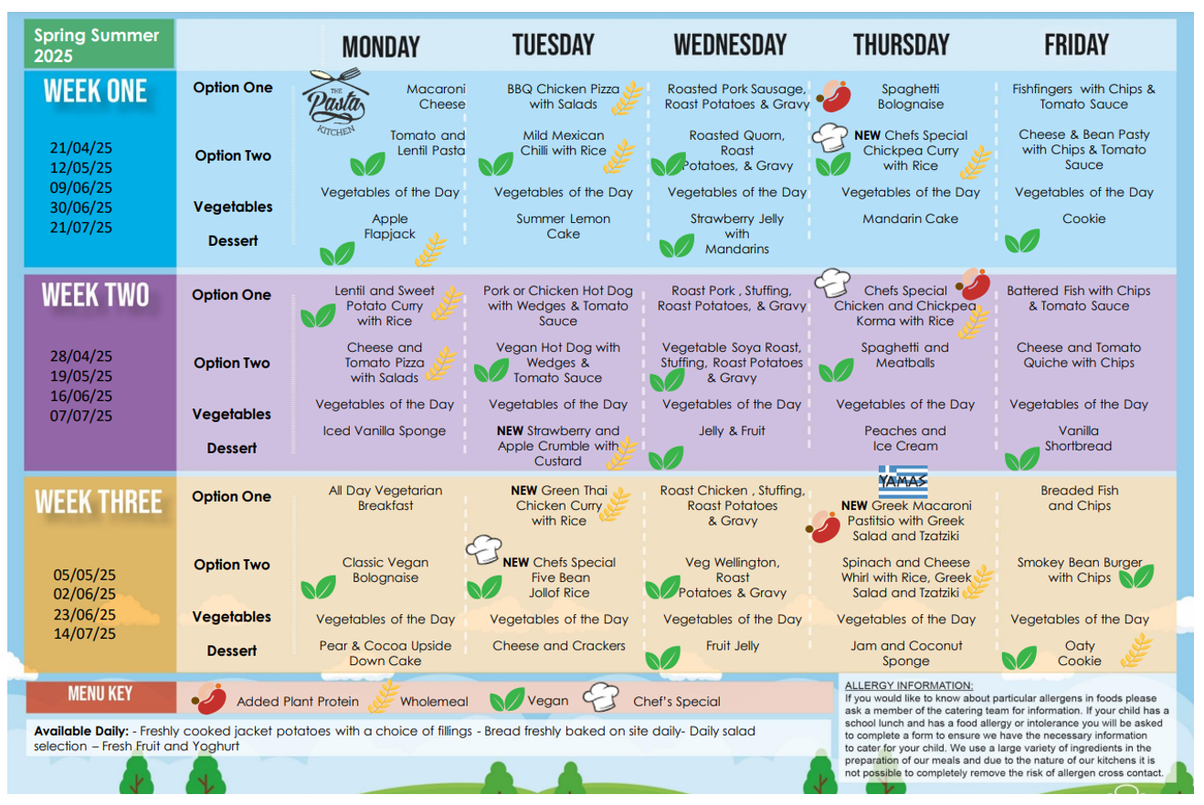
Food and snacks

Slide 18
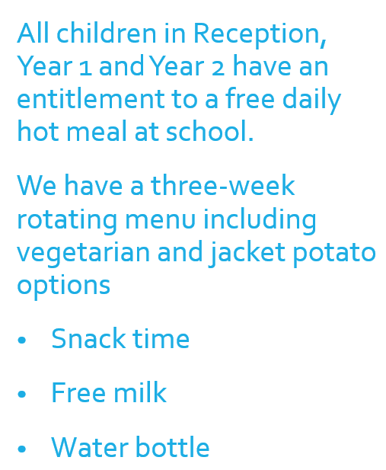
Order by a Wednesday for the following week.
Food MUST to be ordered in advance by parents via Parent Pay.

Slide 19

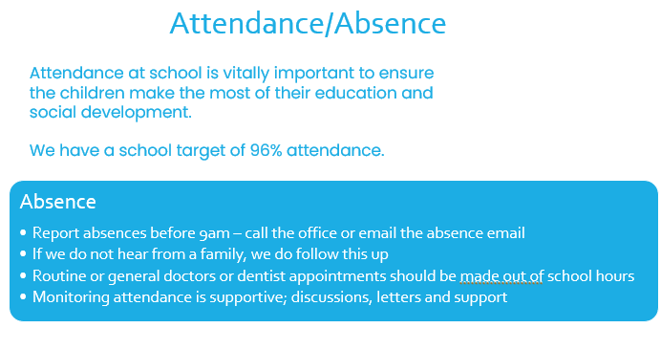
Attendance

Slide 20
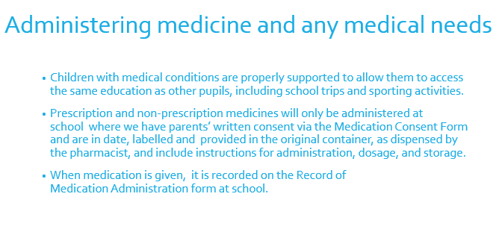

Slide 21
Transition plan for this term and September
1st July 10.15 – 11.15
8th July 10.15 – 11.45
Stay and Play. Children stay in school by themselves for this time. We will collect and dismiss children from the school office.
Home visit – sign up tonight. This is a valuable opportunity to ask any questions you have thought of before the summer break.
September
3rd and 4th September 8.30-12.00. The children go home for lunch – collection from Reception Gate.
7th and 8th – 8.30 – 1.00pm
From 9th – 8.30 – 3.00pm

Slide 22
Question
Time
?

