Slide 1

Year 6 SATs 2026 Presentation
Monday 26th January 2026

Slide 2
What are the SATs?
SATs are the Standardised Assessment Tests that are given to children at the end of Key Stage 2.
The SATs take place over four days, starting on Monday 11th May ending on Thursday 14th May.
The SATs papers consist of:
  Grammar, punctuation and spelling (paper 1: GPS) – Monday 11th May
  Grammar, punctuation and spelling (paper 2: Spelling) – Monday 11th May
  Reading – Tuesday 12th May
  Maths (paper 1: Arithmetic) – Wednesday 13th May
  Maths (paper 2: Reasoning) – Wednesday 13th May
  Maths (paper 3: Reasoning) – Thursday 14th May
Writing is assessed using evidence collected throughout Year 6. There is no Year 6 SATs writing test.
The key stage 2 tests will be taken on set dates unless your child is absent, in which case they may be able to take them up to 5 school days afterwards.

Slide 3
When and how the SATs are completed
The tests take place during normal school hours, under exam conditions.
Children are not allowed to talk to each other from the moment the assessments are handed out until they are collected at the end of the test.
After the tests are completed, the papers are sent away to be marked externally.
The results are then sent to the school in July and we will share them with you in their school report.
Each test lasts no longer than 60 minutes:
  Spelling, punctuation and grammar (paper 1: Grammar/ Punctuation) – 45 minutes
  Spelling, punctuation and grammar (paper 2: Spelling) – 15 minutes
  Reading – 60 minutes
  Maths (paper 1: Arithmetic) – 30 minutes
  Maths (paper 2: Reasoning) – 40 minutes
  Maths (paper 3: Reasoning) – 40 minutes

Slide 4
Specific arrangements for SATs
Children with additional needs (who have similar support as part of day-to-day learning in school) may be allotted specific arrangements, including:
Additional (extra) time;
Tests being opened early to be modified;
An adult to scribe (write) for them;
Using word processors independently;
An adult to read for them (including a translator);
The use of prompts or rest breaks;
Arrangements for children who are ill or injured at the time of the tests.
It is important to note that children cannot have any part of the reading test read to them.
Pupils with an EHCP are automatically allowed up to 25% additional time (except for the spelling paper, which is not strictly timed). Pupils who use the modified large print or braille versions of the tests are automatically allowed up to 100% additional time.
Notes:
The DfE Key Stage 2 access arrangements guidance (https://www.gov.uk/government/publications/key-stage-2-tests-access-arrangements) gives more details on this, including which arrangements need prior permission.
It should be noted that there are cases when pupils can have access to multiple arrangements (e.g. addition time and a scribe). These are detailed in the above document.
Also note, any pupil can ask for a question to be read to them, though not explained to them. In mathematics, words and numbers may be read but mathematical symbols cannot be read.

Slide 5
The results
Tests are marked externally. Once marked, the tests will be given the following scores:
A raw score (total number of marks achieved for each paper);
A scaled score (see below);
A judgement on if the National Standard has been met.
After marking each test, the external marker will convert the raw score to a scaled score. Even though the tests are made to the same standard each year, the questions must be different. This means the difficulty of the tests may vary. Scaled scores ensures an accurate comparison of performance over time.
Scaled scores range from 80 to 120.
A scaled score of 100 or more shows the pupil is meeting the National Standard.
Notes:
There is no separate test that would indicate a pupil is working above the national standard.
A scaled score of less than 99 would indicate a pupil is working below the national standard.
To have a scaled score, pupils must have a minimum raw score (determined each year). If the pupil does not achieve the minimum raw score, they have not demonstrated sufficient understanding of the KS2 curriculum in the subject.

Slide 6
Grammar, Punctuation and Spelling: Monday 11th May
Grammar, punctuation and spelling consists of two papers.
Paper 1 focuses on all three elements (grammar, punctuation and spelling or GPS). The paper lasts for 45 minutes.
Paper 2 consists of a spelling test only. It should take approximately 15 minutes, although this is not a set amount of time (pupils should be given as much time as they need to complete the test).

Slide 7
Grammar, Punctuation and Spelling: Paper 1 (GPS)
The children will have been working hard with their class teacher on developing and securing their knowledge of the technical vocabulary needed in this test.
This test focuses on:
Grammatical terms/ word classes;
Functions of sentences;
Combining words, phrases and clauses;
Verb forms, tenses and consistency;
Punctuation;
Vocabulary;
Standard English and formality.
This test requires a range of answer types but does not require longer formal answers.
Notes:
The question types include:
Circling
Drawing lines to connect
Multiple choice questions (including ticking tables)
One-word answers
Short answer questions

Slide 8



Grammar, Punctuation and Spelling: Paper 1 (GPS)
Example questions:
✔
The council maintain the local park.
Notes:
Questions are from the 2025 GPS SATs paper.
For question 43 the answer scheme details 2 correct answers and answers that should not be accepted (e.g. misspellings of verb forms or errors in punctuation or capitalisation.)

Slide 9


Grammar, Punctuation and Spelling: Paper 2 (spelling)
Paper 2 is a shorter paper that focuses solely on spellings.
Example questions:
Notes:
Questions are from the 2025 Spelling SATs paper.

Slide 10
Reading: Tuesday 12th May
There is one reading test that lasts for 60 minutes.
The test is designed to measure if the children’s comprehension of age-appropriate reading material meets the national standard. There are three different set texts for children to read. These could be any combination of non-fiction, fiction and/ or poetry.
The test covers the following areas (known as Content Domains):
Give/ explain the meaning of words in context;
Retrieve and record information/ identify key details from fiction and non-fiction;
Summarise main ideas from more than one paragraph;
Make inferences from the text/ explain and justify inferences with evidence from the text;
Predict what might happen from details stated and implied;
Identify/ explain how information/ narrative content is related and contributes to meaning as a whole;
Identify/ explain how meaning is enhanced through choice of words and phrases;
Make comparisons within the text.

Slide 11



Reading
The reading SATs paper requires a range of answer styles.
Example questions:
Notes:
Questions are from the 2025 Reading SATs paper.
Question styles include:
Multiple choice questions
One-word answers
Short answer questions
Multiple mark (long answer) questions

Slide 12




Reading
Example questions:
Notes:
Questions are from the 2025 Reading SATs paper.

Slide 13



Reading
Example questions:
3 mark question
Notes:
Questions are from the 2025 Reading SATs paper.

Slide 14
Reading
Since the current testing formation for the SATs began in 2016, there has been a tendency for three types of questions to be the most popular.
In the 2025 Reading SATs paper,
12% of marks could be gained from answering questions involving giving and explaining the meaning of words in context;
30% of marks could be gained from answering questions involving retrieving and recording information or identifying key details from a text;
48% of marks could be gained from answering questions involving making inferences from a text and justifying inferences with text evidence.
When reading with your child at home try focusing on these types of questions.
Notes:
6% of questions: summarising main ideas from more than one paragraph.
2% of questions: making comparisons within the text
2% of questions: Identify and / or explain how meaning is enhanced through choice of words and phrases.
Example questions to ask at home:
What does this word mean?
Which word in this paragraph is the closest in meaning to…?
What [character] doing when [event] happened?
True or false questions about a paragraph/ text.
Why do you [character] did [event]? Can you think of another reason?

Slide 15
Maths: Wednesday 13th May and Thursday 14th May
The maths assessments consist of three tests.
Paper 1: Arithmetic (30 minutes) – Wednesday 13th May
Paper 2: Reasoning (40 minutes) – Wednesday 13th May
Paper 3: Reasoning (40 minutes) – Thursday 14th May

Slide 16


Maths Paper 1 (Arithmetic)
The maths arithmetic paper has a total of 40 marks and lasts for 30 minutes.
The test covers the four operations (addition, subtraction, multiplication, division, including order of operations requiring BIDMAS), percentages of amounts and calculating with decimals and fractions.
Example questions:
Notes:
Questions are from the 2025 Arithmetic SATs paper.
Identify that there are some questions that have 2 marks and some that have 1.

Slide 17

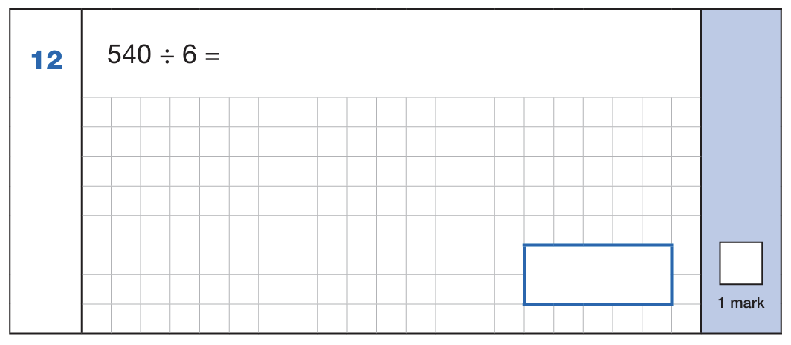

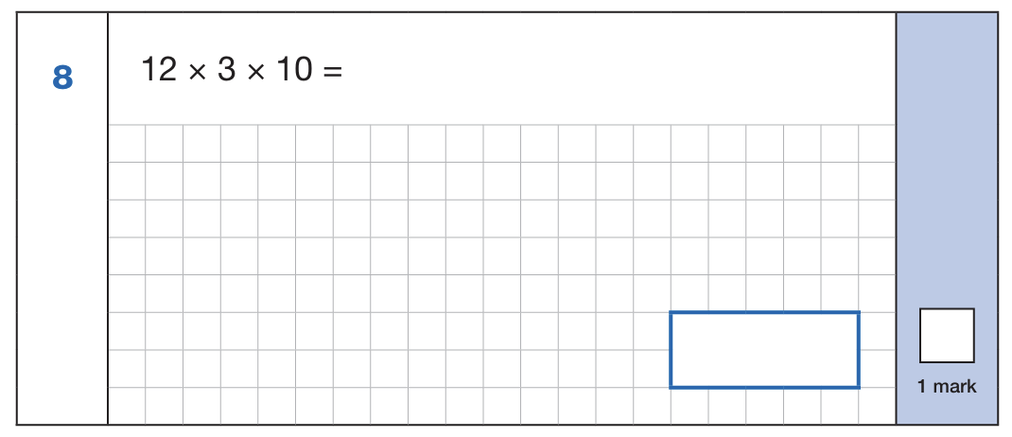
Maths Paper 1 (Arithmetic)
Example 1 mark questions:
Using known fact of 10% of 860 = 86
And 5% is half of 10%
86 ÷ 2 = 43
43
Known facts: 54 ÷ 6 = 9
90
Mental method:
Using known fact of 64 ÷ 8 = 8
80
⅝ x ⅓
5 x 1 = 5
8 x 3 = 24
⅝ x ⅓ = 5/24
5/24
12 x 3 = 39
39 x 10 = 390
390
Notes:
Questions are from the 2025 Arithmetic SATs paper.
These are examples of how children could solve the calculations. There are some that could/ should be solved mentally as it is far quicker that way (40 marks in 30 minutes does not allow for 1 minute + per mark).
Answers should always be given in their simplest form unless stated otherwise.
Note that for question 26, equivalent fractions or the exact decimal are accepted.

Slide 18


Maths Paper 1 (Arithmetic)
Example 2 mark question:
Notes:
Questions are from the 2025 Arithmetic SATs paper.

Slide 19
Maths Papers 2 and 3 (Reasoning)
Paper 2 will take place on Wednesday 13th May and paper 3 will take place on Thursday 14th May. These tests have a total of 35 marks each and lasts for 40 minutes each.
These papers require children to demonstrate their mathematical knowledge and skills, as well as their ability to solve problems and their mathematical reasoning. They cover a wide range of mathematical topics from key stage 2 including,
Number and place value (including Roman numerals);
The four operations;
Geometry (properties of shape, position and direction);
Statistics;
Measurement (length, perimeter, mass, volume, time, money);
Algebra;
Ratio and proportion;
Fractions, decimals and percentages.
Notes:
In general, the questions get progressively harder throughout the paper. As this is the case, it is not unusual for children to be unable to complete the entire paper in the given time.

Slide 20


Maths Paper 2 (Reasoning)
Example questions:
✔
✔
5
19
✔
7
17
11
13
Notes:
Questions are from the 2025 paper 2 Reasoning SATs paper.

Slide 21


Maths Paper 2 (Reasoning)
Example questions:
Notes:
Questions are from the 2025 paper 2 Reasoning SATs paper.

Slide 22
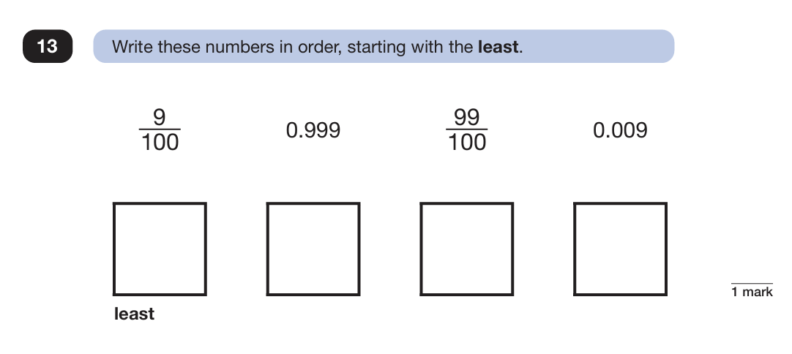
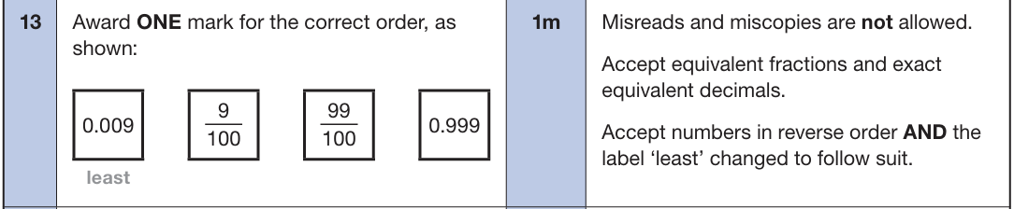
Maths Paper 3 (Reasoning)
Example questions:
Notes:
Questions are from the 2025 paper 3 Reasoning SATs paper.

Slide 23


Maths Paper 3 (Reasoning)
Example question:
Notes:
Questions are from the 2025 paper 3 Reasoning SATs paper.
Note that this is a three mark question.

Slide 24
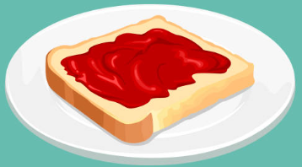


SATs Breakfast Monday to Thursday
During the week we will be opening the school to Year 6 children to come in and have breakfast. There will be a selection of bacon and sausage rolls, toast, cereals and fruit available. We have found that this has really helped the children to settle each day as they socialise and enjoy chatting to each other before the day begins. It helps to create a relaxed atmosphere. Children do not have to come, it is a choice and they can choose to eat or just chat.
There is no cost to parents for this. We are very grateful to FOSS who cover the cost.

Slide 25
Celebration Picnic
On Friday 15th May we take the children to the Rec for a day of fun and games. We will have a picnic and (weather permitting) spend the day relaxing and having fun.

Slide 26
Websites that may be useful
BBC Bitesize: https://www.bbc.co.uk/bitesize/articles/zrybvk7#zs82p9q
Crickweb: http://www.crickweb.co.uk/ks2literacy.html
IXL English resources: https://uk.ixl.com/english/year-6
IXL Maths resources: https://uk.ixl.com/maths/year-6
Maths Playground has lots of games to practise skills: https://www.mathplayground.com/grade_6_games.html

Slide 27
Thank you for coming.
If you have any worries or concerns, please come and talk to us.

