Slide 1

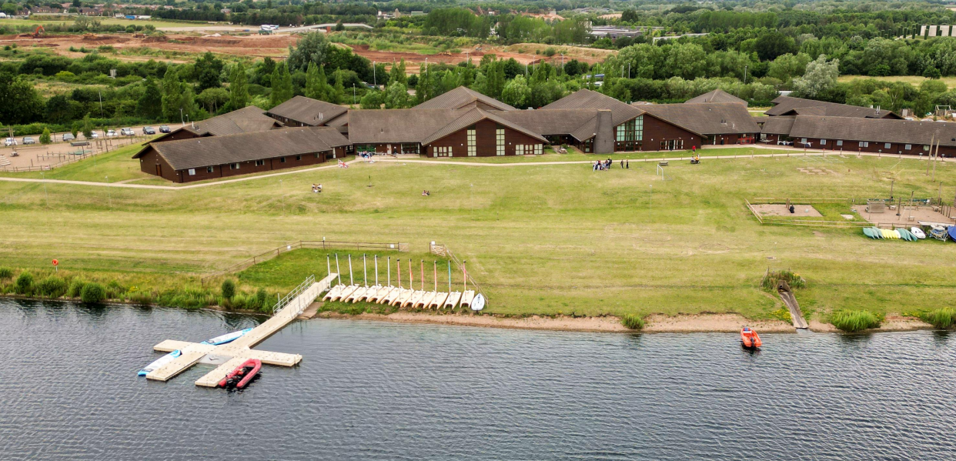
Year 5 Residential
Whitemoor Lakes
Staffordshire
9th March-11th March 2026

Slide 2

Arrival at Whitemoor Lakes
We will arrive at around 11:30am
We get a tour of the site
Settle into our lodge and bedrooms including making the beds
Packed Lunch
First activity to start at 2:00pm

Slide 3
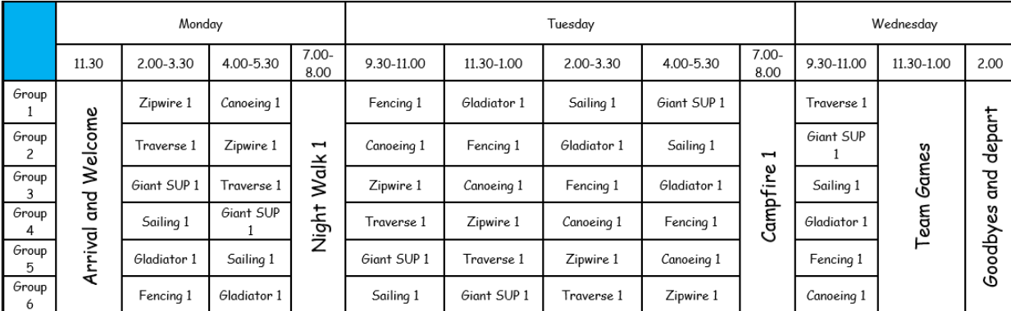
Example of activities we may have

Slide 4
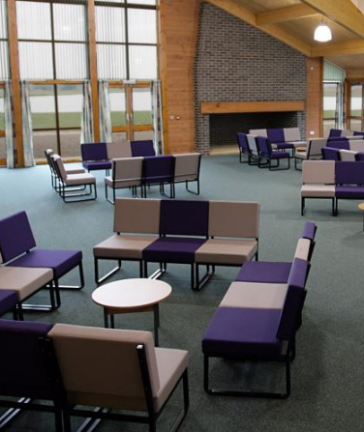
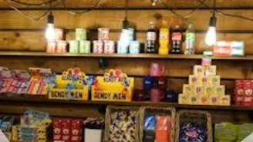

This is a communal area for games, relaxing, and where the main Reception is based.
There is an onsite gift/tuck shop if we choose to book it. (extra cost involved)
Pool, Table Tennis, and Football games cost £0.50 or £1.00 (depending on which one you play).

Slide 5

The Dining Hall
Our school will have allocated tables and a serving point.
Any dietary requirements / allergies will be catered for if pre-arranged.
Drinks are available during each meal.
The salad bar is available during lunch and supper.

Slide 6


Slide 7
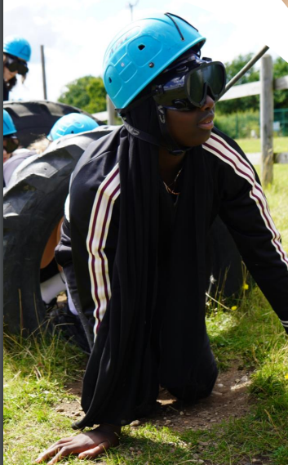

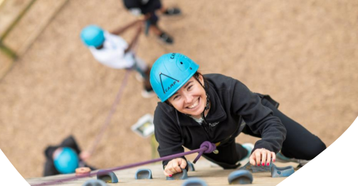
Instructor Led Activities
Our group will be in a group of 12 plus 1 group leader/teacher
Day time activities are 90 minutes
Evening activities are 60 minutes.

Slide 8
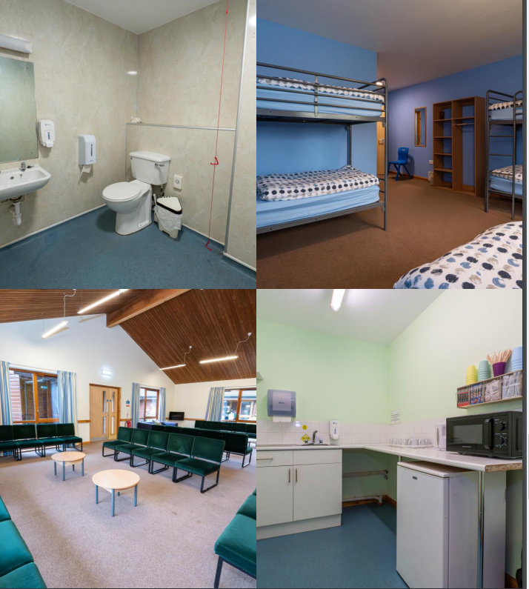
Every school gets their own Lodge for accommodation.
All rooms are multi bedded and have en-suite bathrooms.
Every lodge has a Lounge/Day Room and a small kitchenette area.
We provide 2 pillows and duvet.

Slide 9

Safety at the site
Our Arrival Site Tour gives everyone onsite all rules and the opportunity to ask questions.
There is a manned Reception Desk from 8am until 10pm.
There is a Night Porter from 10pm until 8am.
There is First Aid available. (staff attending are first aid trained)
Security is very important; there is full site lock up and a secure full perimeter fence.
All the Fire Exists are alarmed so we are aware if anyone exits.
The site has CCTV throughout.

Slide 10
Costs involved
Centre cost - £157 per child for 3 days activities
There will be an additional cost added to this to cover coach travel to and from Staffordshire.
The extra cost amount will depend on number of pupils who attend.
For example, if 20 pupils attend total cost will be £245.90
This would break down into:
£60 deposit (this is non-refundable)
Then the remainder will be broken down into several payments spread out.

