Slide 1

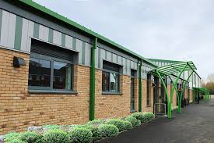

Slide 2

Our vision…
Shrivenham School gives everyone the opportunity to believe in themselves, others, and God. Through our values of love, hope and courage, everyone at our school will flourish, fulfil their unique potential and positively contribute to the community.

Slide 3

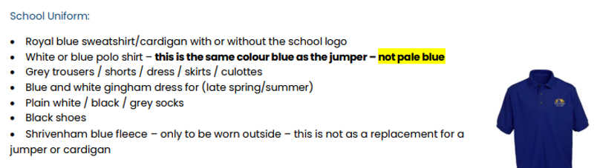
Uniform
Winter:
Scarf, hat gloves and a warm coat.
Summer:
Sun cream applied at home, summer hat and a water bottle!

Slide 4
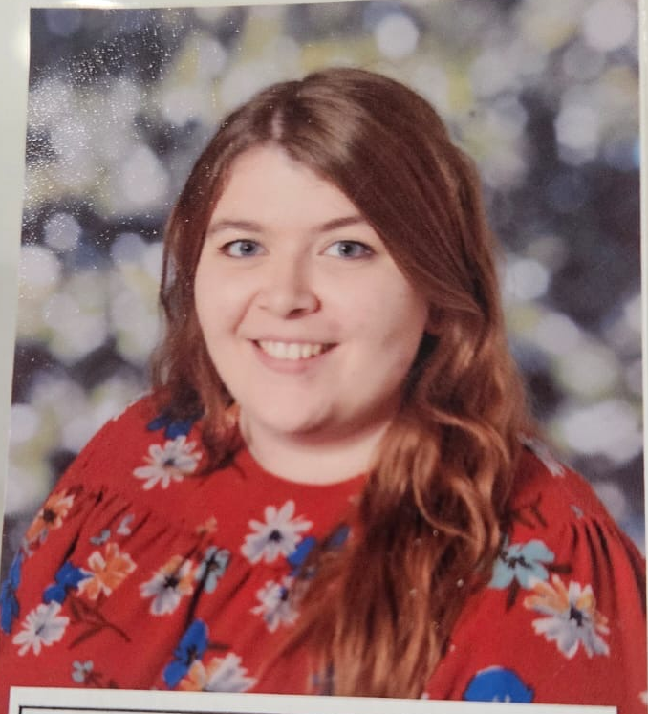
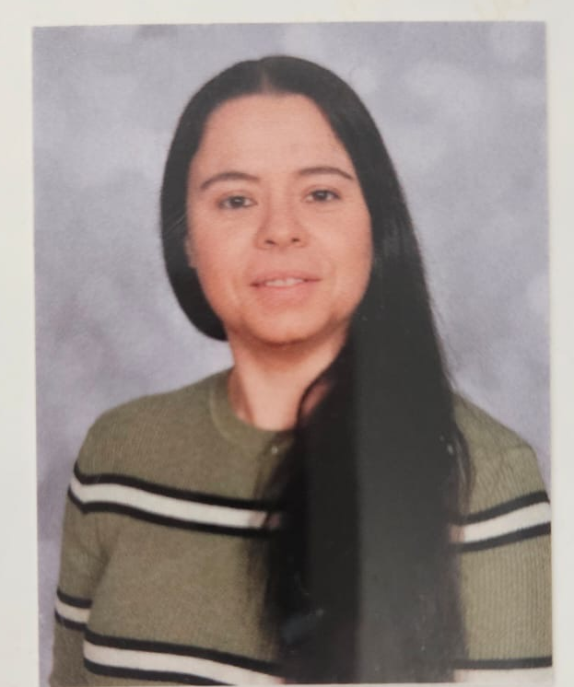
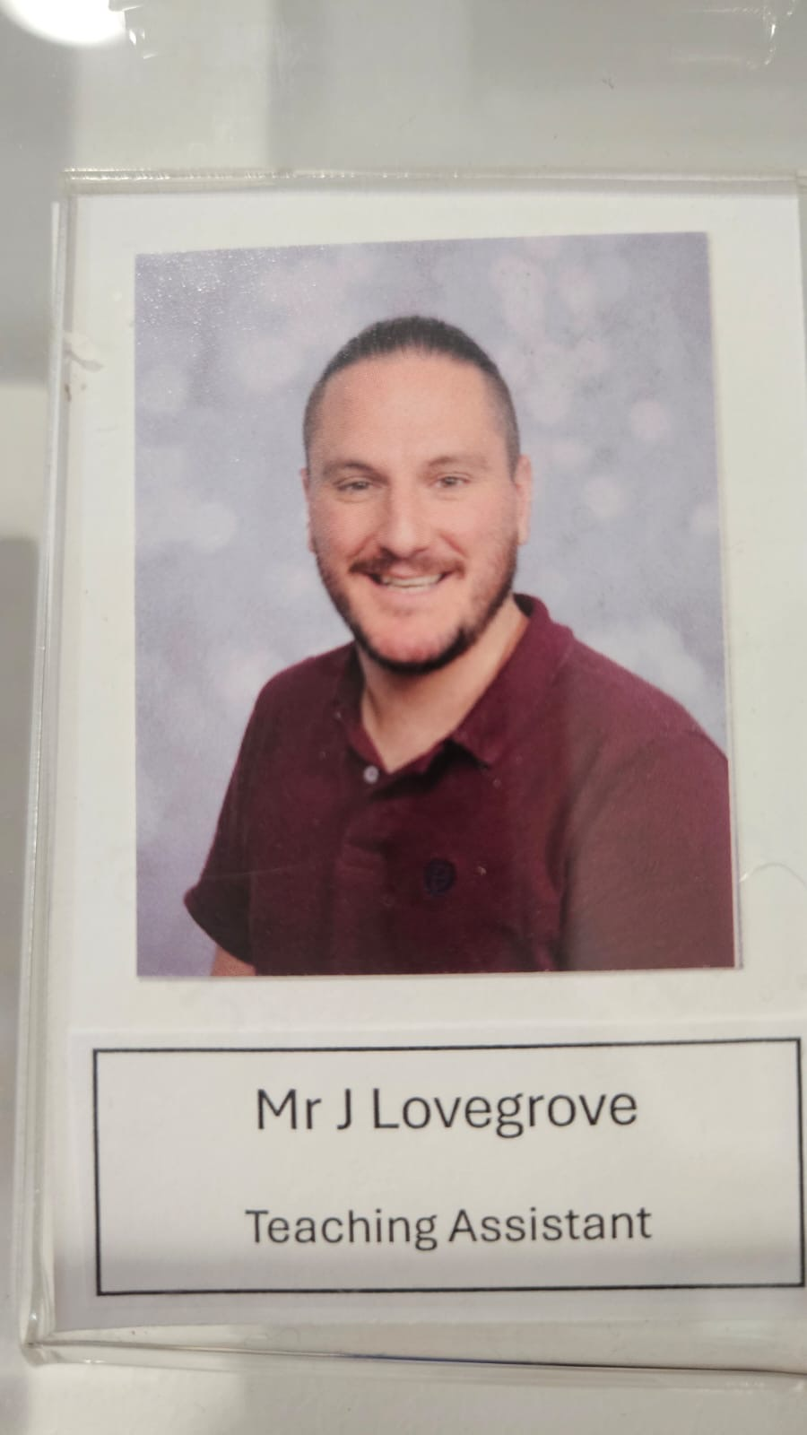
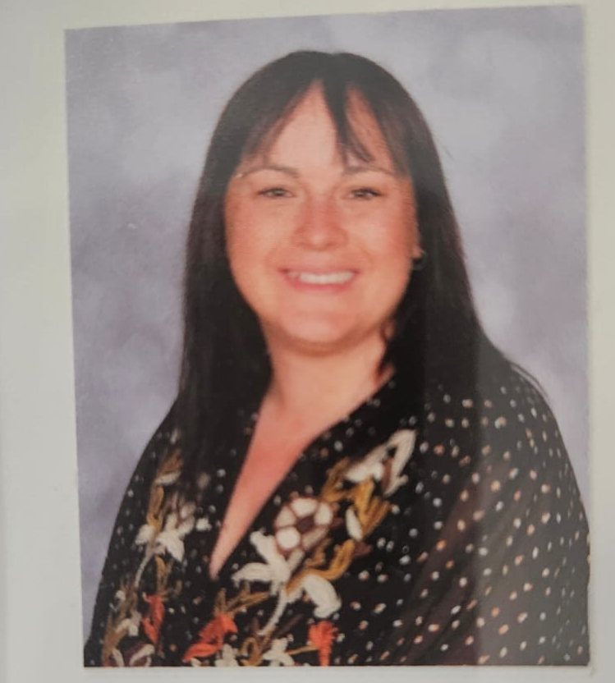
Welcome to our school
Adults in Birch class
Mrs Jefferies
Class Teacher
Mrs Butler
HLTA - Mondays
Mrs Forrester
Teaching Assistant
Mr Lovegrove
Teaching Assistant

Slide 5
What does a day in Walnut class look like?
8:30 - Arrive at school
8:40 - Register and lunch choices
8:45 – Reading
9:15 – Maths
10.15 – Break time
10:30 - English
11:30 - Maths MOT
11:55 - Story
12:00 - Lunch
1:05 - Collective worship
1:20 - Curriculum
2:00 - Curriculum
3:00 - Home

Slide 6
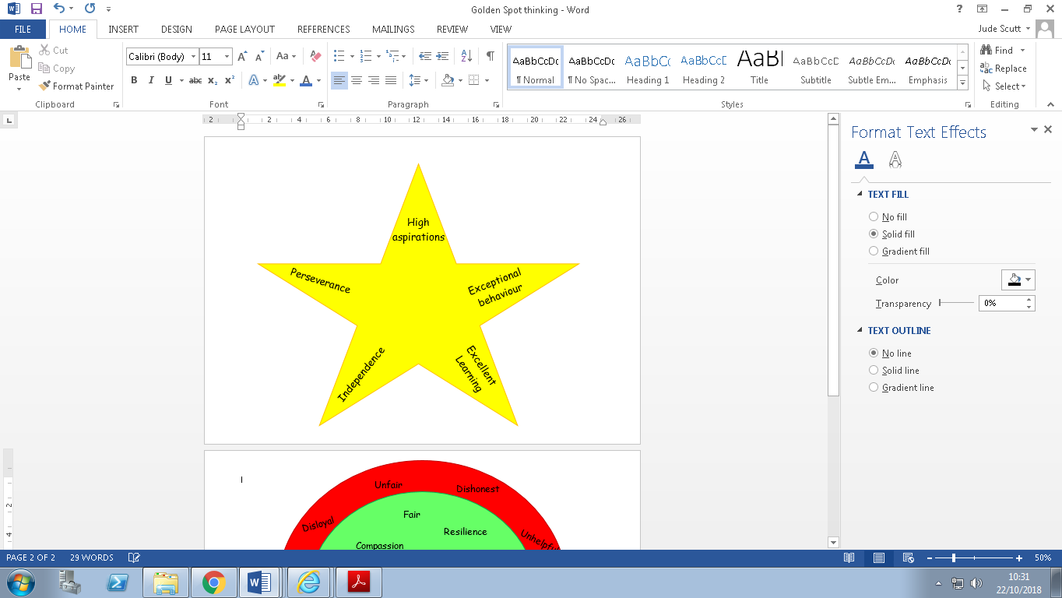

Expectations
At school, it is expected that children will behave well all of the time – not only during learning time in the classroom, but at playtime, lunchtime, moving around school and during extra-curricular activities. Children are taught to understand that they should behave respectfully to each-other and to all adults.
We want our children to take personal responsibility for the choices they make and understand the consequences for their choices including the impact it has on themselves as well as others. We spend time demonstrating and discussing this through daily teaching and weekly PSHE lessons.
A copy of our new Relational Policy can be found on the school website and will be emailed to all parents.

Slide 7
Curriculum
Details about the curriculum for each subject can be found on the school website.
This year, the enquiry topics for Walnut class will be:
Term 1&2 – How Greek are we?
Term 3&4 – What can we learn from looking back? (Romans)
Term 5&6 – Why are rainforests important?
An overview for each term will be posted on the class webpage.

Slide 8
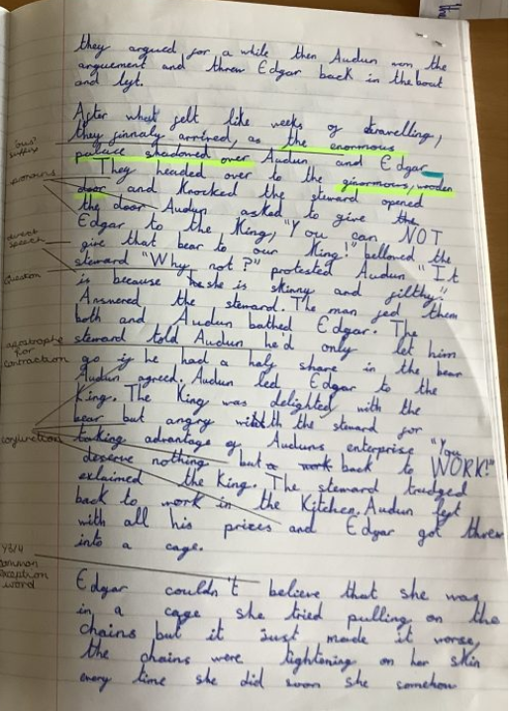
Writing Standards
This is a piece of writing that shows the expected standard by the end of this school year…

Slide 9



Homework
This year, there continues to be an emphasis on reading and times tables for homework. Children are expected to read 5 x a week at home and to practise their number bonds and times tables using Numbots and Times Tables Rock Stars at least 3 x per week.
Children will also need to learn their weekly spellings. The term’s spellings will be handed out at the beginning of each term and will also be available on the class page on the school website.
Weekly certificates for Numbots and Times Tables Rocks Stars will be shared on a Monday assembly.

Slide 10
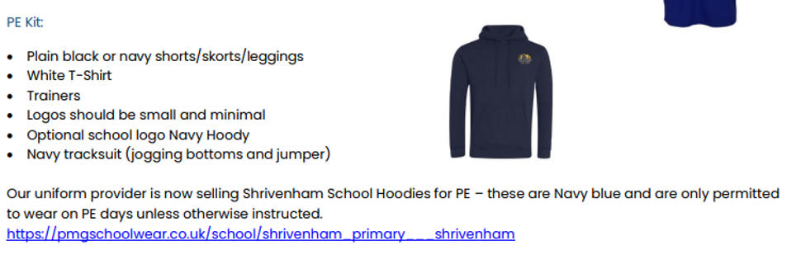

PE
Children will have two PE lessons every week (Tuesday and Wednesday). Children must come to school wearing their PE kit on these days.
When the weather allows, this will be outside so please ensure, the children have warm layers as it gets colder.

Slide 11
Lunches, snacks and drinks
All children in Reception, Year 1 and Year 2 have an entitlement to a free daily hot meal at school and children in Years 3-6 can purchase hot lunches through ParentPay (£2.70). We have a three - week rotating menu including vegetarian and jacket potato options. These are ordered daily by the children.
KS1 also have free fruit which is provided daily but children are welcome to bring their own healthy snack if they wish; we encourage fruit, veg, yogurts, cheese and healthy cereal bars.
We have free daily milk for children up to the age of 5. Once they have turned 5, this can be purchased through the Cool Milk company.
It is vital that every child has a water bottle in school (water or squash). The children are encouraged to drink regularly throughout the day to aid hydration and concentration.
Useful Information | Shrivenham Church of England Primary School (shrivenhamschool.co.uk)
Please remember we are a nut free school – this includes hazelnut chocolate spread and some cereal bars

Slide 12
Pupil Premium
Your child may be able to get free school meals if you get any of the following:
Income Support
income-based Jobseeker’s Allowance
income-related Employment and Support Allowance
support under Part VI of the Immigration and Asylum Act 1999
the guaranteed element of Pension Credit
Child Tax Credit (provided you’re not also entitled to Working Tax Credit and have an annual gross income of no more than £16,190)
Working Tax Credit run-on - paid for 4 weeks after you stop qualifying for Working Tax Credit
Universal Credit - if you apply on or after 1 April 2018 your household income must be less than £7,400 a year (after tax and not including any benefits you get)
Children who get paid these benefits directly, instead of through a parent or guardian, can also get free school meals.
Please speak to the school office if you think you are eligible.

Slide 13
Service Pupil Premium
Pupils attract SPP if they meet one of the following criteria:
• one of their parents is serving in the regular armed forces (including pupils with a parent who is on full commitment as part of the full time reserve service)
• they have been registered as a ‘service child’ on a school census since 2016, see note on the DfE’s ever 6 service child measure
• one of their parents died whilst serving in the armed forces and the pupil receives a pension under the Armed Forces Compensation Scheme or the War Pensions Scheme
Please speak to the school office if you think you are eligible.

Slide 14

Attendance/Absence
Attendance at school is vitally important to ensure the children make the most of their education and social development. We have a school target of 96% attendance across the year and we monitor this very closely.
Absence
If your child is going to be absent from school, you have to ensure you have made contact with the school office before 9am. This can be by email or telephone.
If we do not hear from a family, we will follow this up as it is our duty to safeguard every child.
We understand that sometimes children are poorly or medical appointments can’t be avoided during the school day but where possible we would ask that routine/general appointments are made outside of the school day.
We monitor attendance on a termly basis and send letters to parents where attendance is a concern. This is a supportive approach and we will always listen and offer advice and support where possible.

Slide 15

SEN and Pastoral support
As a school, we take pastoral care and wellbeing very seriously and it is at the forefront of our school’s vision of leading a mentally healthy school so that 'all things are possible'.
Mrs Forrester is our Pastoral Assistant for the school. She works 5 days per week and liaises with all class teachers and teaching assistants regarding the well-being of the children on a day to day basis.
As a school we believe and value each of our children as unique and individual, we believe that they all flourish in their own time with the right support and nurture. Children who are identified to have additional needs are supported to allow them to reach their full potential.
Mrs Staples our Special Educational Needs Coordinator and can be contacted for any concerns or support you may have. She works closely with staff and external agencies to support pupils who need extra help to achieve their full potential at school.

Slide 16

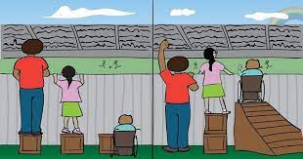

Inclusive Education
SEND is currently identified by four groups;
Communication and Interaction (including Autism Spectrum)
Cognition and Learning (including Dyslexia)
Social, Emotional & Mental Health
Sensory and/or Physical Needs
Oxfordshire Local Authority
Oxfordshire SEND Local Offer
Family Information Directory
Swindon Borough Council
https://localoffer.swindon.gov.uk/home
Further details advice and activities can be found on our school website: https://www.shrivenhamschool.co.uk/send/

Slide 17
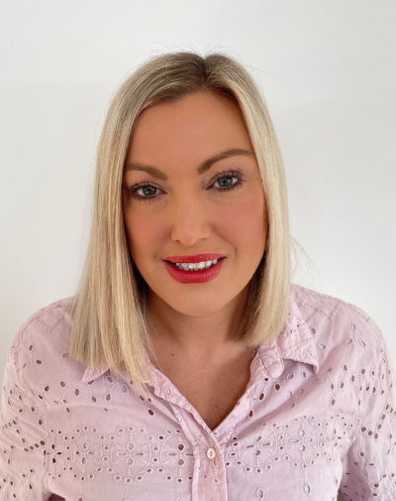
Home School Link Worker
We know that a strong connection between home and school is key to every child's success. That's why we're proud to have a dedicated Home School Link Worker (HSLW) as part of our team.
Our HSLW is here to support not just children, but families too. Whether you're facing challenges at home, need help navigating school processes, or just want someone to talk to, our HSLW is a friendly and understanding point of contact. They work closely with parents and carers to help ensure every child feels safe, supported, and ready to learn.
Some of the ways our HSLW can help include:
Offering advice and support with parenting, routines, and behaviour
Connecting families with local services and resources
Supporting attendance and helping overcome barriers to learning
Helping families through times of change or difficulty (e.g., bereavement, family breakdown)
Building positive relationships between home and school
They are available for informal chats, one-to-one support, or just a listening ear when needed.
Our HSLW is here to make sure no family feels alone – we are all part of the same team, working together for our children’s well-being and success.
If you'd like to find out more or get in touch with our Home School Link Worker, please contact the school office.

Slide 18
Administering medicine and any medical needs.
Children with medical conditions are properly supported to allow them to access the same education as other pupils, including school trips and sporting activities.
Prescription and non-prescription medicines will only be administered at school where we have parents’ written consent via the Medication Consent Form and are in date, labelled and provided in the original container, as dispensed by the pharmacist, and include instructions for administration, dosage, and storage.
When medication is given, it is recorded on the Record of Medication Administration form at school.

Slide 19
How do we communicate with parents?
Website
    Curriculum
    Important information such as term dates, uniform, support (SEN, pastoral etc)
Updates through ParentPay
Class pages on the website
    Topic overviews
Class Dojo
www.shrivenhamschool.co.uk

Slide 20
Contact details:
Office email:
office@shr.cambrianlt.org

