Slide 1
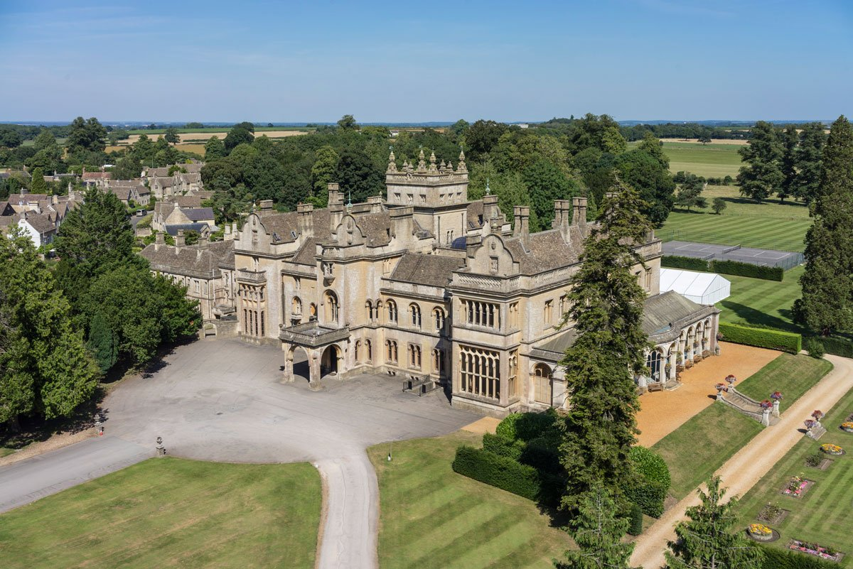
Year 6 Residential
July 7th to 11th
Grittleton House
Chippenham

Slide 2
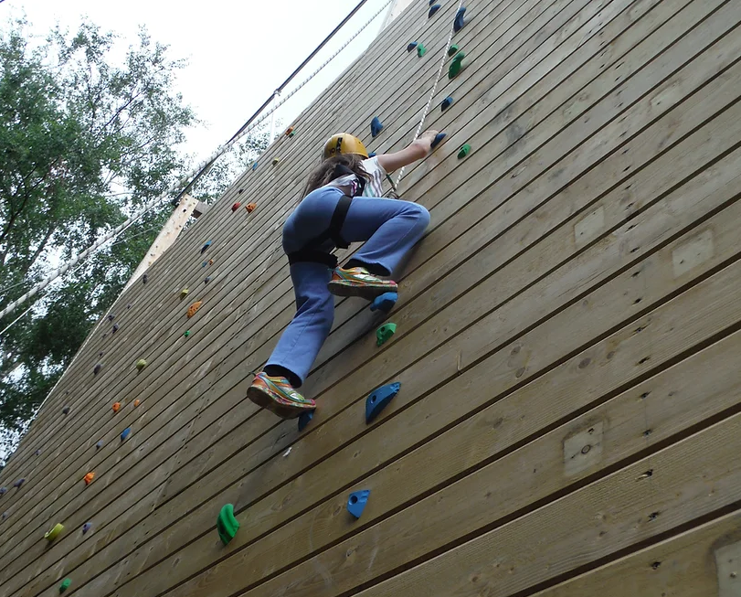
As last year, we will be returning to Grittleton House in Chippenham.
We will be leaving school at 10am on Monday 7th July, travelling straight to the centre to begin our activities after lunch. Everyone will need to bring a packed lunch for this first day.
We will return on Friday 11th July at approximately 1pm.

Slide 3
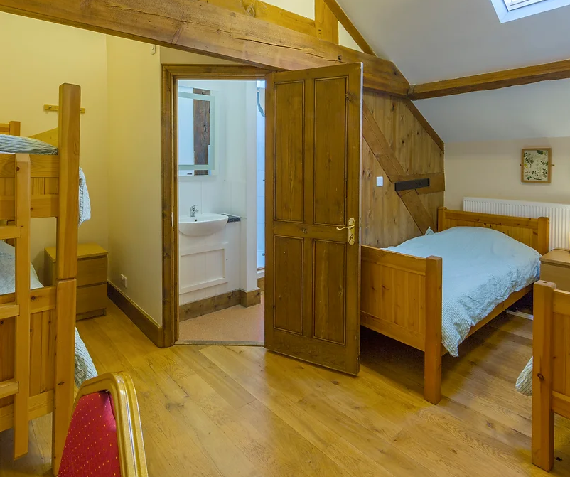
Duvets and pillows are supplied.
Children will sleep in small dormitories of between 4 and 10 beds and some will share a bathroom.

Slide 4
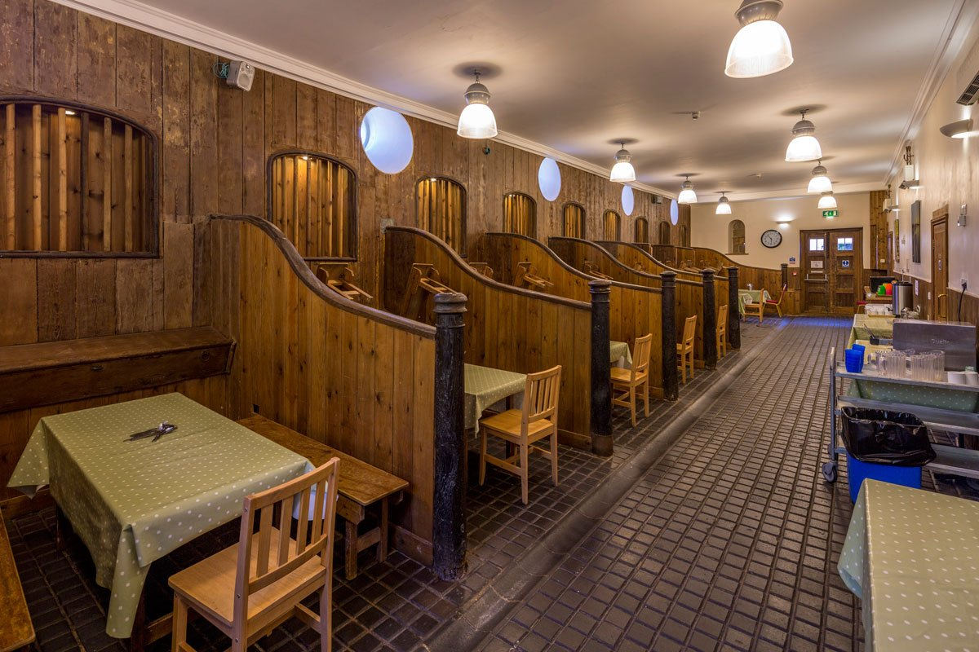
The dining room is set in the old stables. The children are able to sit at tables with their friends.
All the food is prepared on site and the children are individually served.
The centre provides a healthy balanced diet using locally sourced ingredients where possible.
They are able to cater for specific dietary requirements and allergies and we will be asking you well in advance to tell us of these.

Slide 5

There are many different activities available for us to take part in.
The grounds are extensive, set across 30 acres, enabling us to do lots of different things.
Grittleton provide adventure activities but also challenging problem solving and team building development sessions.
At the moment we are in discussions with the centre about what the weeks programme will be.
After dinner each night there is a further activity led by the staff from the centre.

Slide 6
Staffing:
Currently there will be 3 members of staff attending. This ensures a ratio of 10:1 as required for a residential trip. There is a possibility of further staff attending if required.
The centre provides fully qualified staff to run the activities and each night a member of the centres staff is on site.

Slide 7
Costs:
£450.00 per child
We have secured 30 places and the cost includes:
Coach travel to and from the centre
Accomodation, including bed linen
All food, 3 meals a day and snacks
All activities, including equipment needed.
Insurance

Slide 8
Payments
To secure a place, we are asking for a deposit of £80 to be paid via ParentPay by December 17th.
This will be followed by payments of £61.20 to be paid by the 17th of January, February, March, April, May and June.

Slide 9
Payments:
We are asking that if you would like your child to attend, please pay a deposit of £50 by the end of November.
You can then pay the balance in 5 instalments of £67 and a final installment of £65..
We will be sending a letter home tomorrow, which you will need to sign, giving your consent and it needs to be returned by 17th December and the deposit paid via ParentPay.

Slide 10
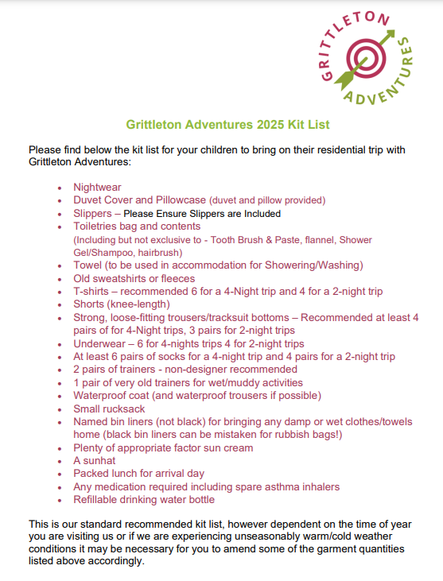
This is the kit list that Grittleton have now supplied us with.
The main change is that they now require every child to bring a duvet cover and pillow case.

Slide 11
Thank you very much for coming.
We will be sending home a letter over the next few days and asking you to pay a deposit of £50 by Tuesday 17th December.

