Slide 1
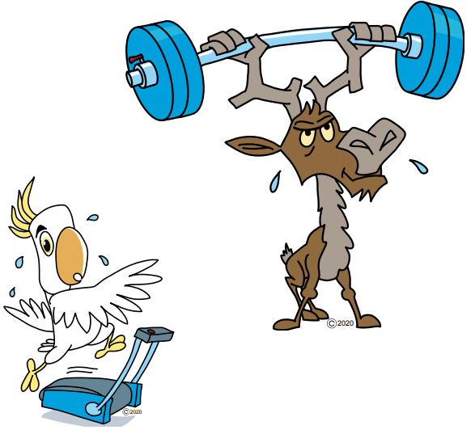
Welcome to Maths at Shrivenham C of E Primary School
Information evening for parents
17.06.21

Slide 2

Aims for todays meeting:
Introduce Can Do Maths
Our Intent
How do we teach it
What a typical lesson looks like
The calculation policy
The curriculum map
How you can support your child
How we assess
Any questions

Slide 3

What is Can Do Maths?
Can Do Maths was created by three
Maths teaching specialists. They all saw that too many children believed that they were ‘no good’ at maths. They wanted to change this whole mindset and show ALL children that they CAN do Maths.
Can Do Maths was devised by Dave Bowman (@Maths4UkPLC), Steve Lomax (@MaxTheMaths) and Liz Hopkins (@BuzzardPublish)
https://www.candomaths.org/

Slide 4

What are the principles?
Teaching for understanding
Belief
Hard work

Slide 5
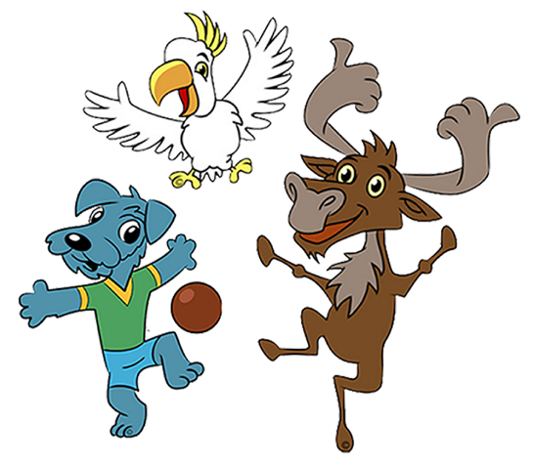
Meet the characters
Colin the Caribou
Coco the cockatoo
KeepitUpuppy

Slide 6
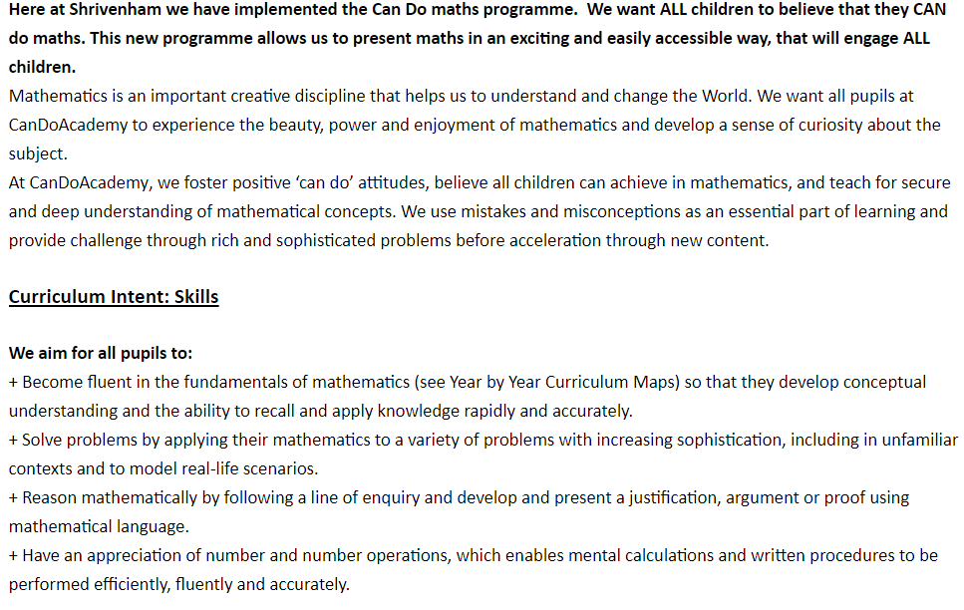
Our vision and intent for Maths at Shrivenham C of E School
*taken from our school website

Slide 7
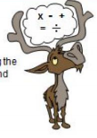
What does a lesson look like?

Slide 8
The lesson has 5 parts and this is the same for EVERY class. It lasts 40 minutes.
We DO NOT expect every child to reach the 4th and 5th step, the important learning is to get to step 3.
Teach it – Here the teacher demonstrates the maths that will be taught that day. The show how to solve the calculation with clear, small steps. Each day these steps build up to allow the children to be able to tackle more complex problems, but this is a very slow step.
Practise It – The teacher will give the class another example and on white boards, the children will attempt it themselves. The whole class will then go through the problem, discussing what they did. Some children at this point will get extra support from a TA or the teacher.
Do It – A maximum of 5 questions will be put on the board for every child in the class to answer. At this point, the TA and the teacher will be supporting those children who need it.
Secure It– A question is given to the children and they have to explain if the answer is correct or incorrect.
Deepen It – A more complicated problem is given.

Slide 9

What happens if a child does not complete step 3 and is struggling?
This is an extremely important question.
Every day, there is a further 20 minute maths session.
During this time, those children who have struggled with that days lesson will receive targeted support with either the teacher or the TA.
The other children in the class will receive work that is ether recapping previous learning or, consolidation work from that days lesson.
With this programme, no child should be left behind.

Slide 10
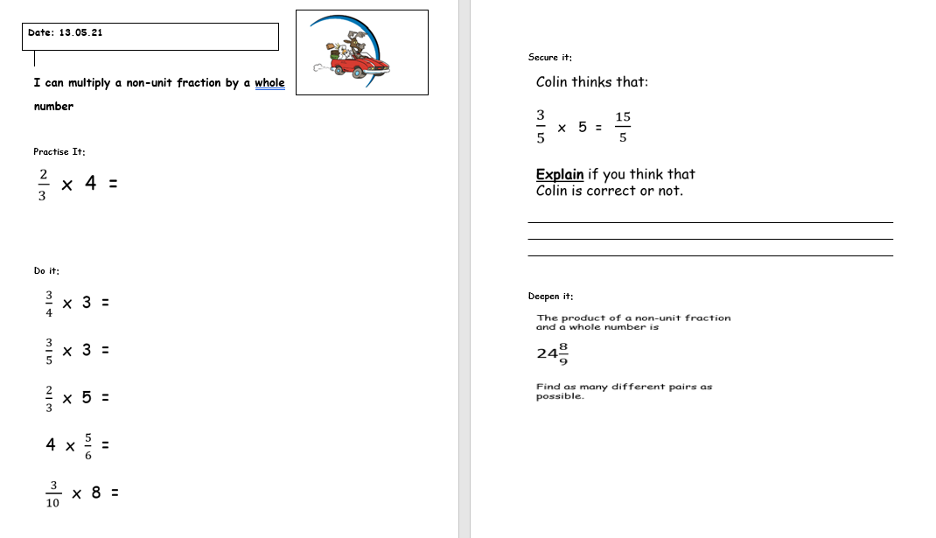
Each day your child’s teacher will produce a sheet like this for every child in the class. It shows you the steps and examples. Please note that this is Year 5 sheet.

Slide 11
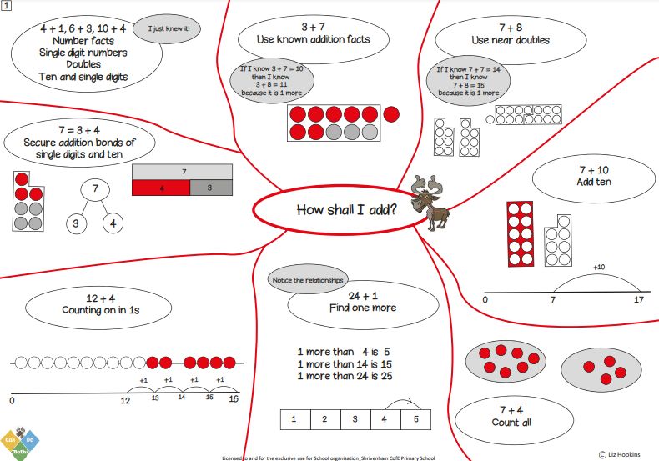
The Curriculum Policy
Our curriculum policy, which you will find in full on the school website, shows how maths develops from Year 1 to Year 6. For example, you can see on the screen all the different ways we use to teach children how to add.

Slide 12
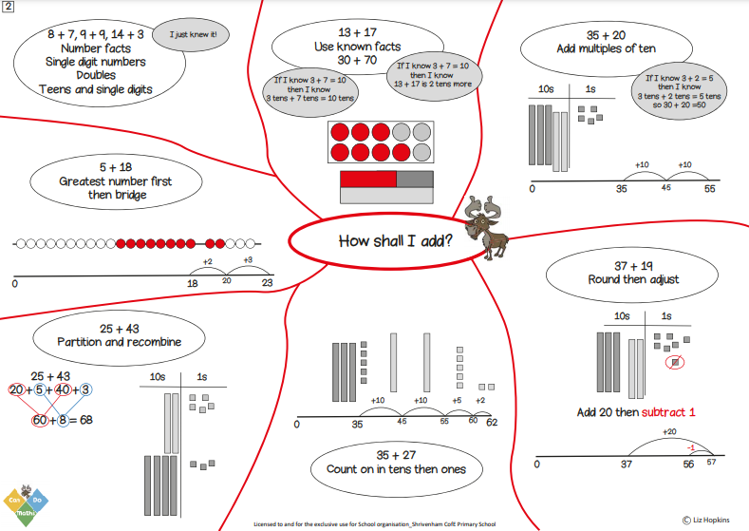
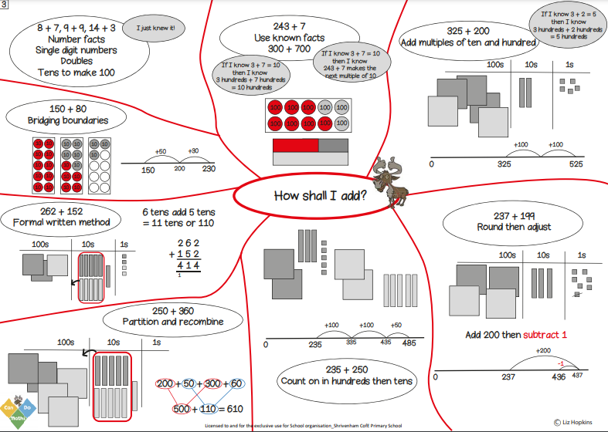
Here are the Year 2 and 3 pages. What you can see is how the value of the numbers increases and how the methods the children have previously learned can enable them to deal with this.

Slide 13
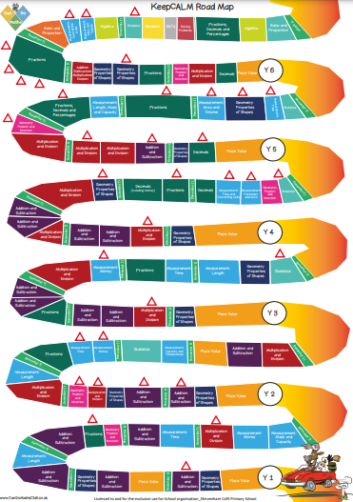
The Curriculum Roadmap
This document, which is available on the school website, shows you exactly what maths topics your child will covering each year.

Slide 14
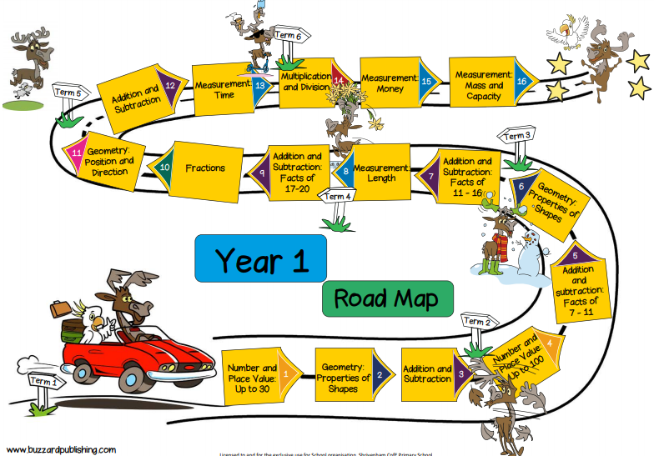
This shows you all the topics that your child will have covered or will cover in Year 1. All individual Year groups Road Maps are available on the website.

Slide 15

How can you help your child?
Supporting your child with maths can be hard. Many of the methods have changed and this can be very confusing for parents. To help you with this, the curriculum policy, Year group Roadmaps and the knowledge organizer provide lots of examples.

Slide 16
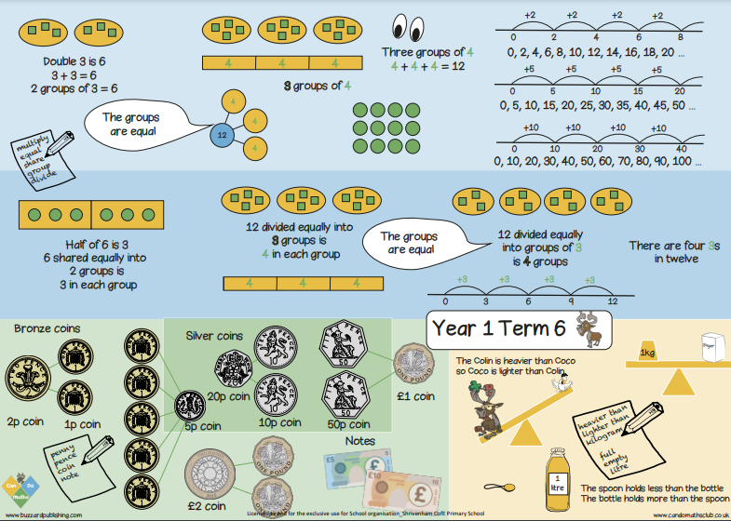
Each term, you will be able to find the knowledge organiser for your child on the website. This will show you what topics are being covered that term and so help you to prepare for helping your child.

Slide 17

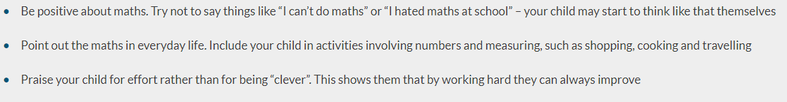
Top tips for parents
(taken from the National Numeracy website - https://www.nationalnumeracy.org.uk/helping-children-maths
Try to enforce the ‘I Can’
BUT most importantly, rather than struggle with maths homework, use a completely different way to help…….GAMES! We do NOT want to make yours and your child's life at home miserable with trying to go over methods they are finding hard, so games are a great way to practice, without them realising what we are trying to achieve.

Slide 18
Games
Rather than start with the ‘hard stuff’ begin with something fun. Playing games with your child is a brilliant way to support them with maths. Rather than having a stressful time with your child trying to do ‘sums’, games can make the learning fun for both of you.
Snakes and Ladders – a brilliant game for mental addition and subtraction.
Snap – a simple matching game
Dice – Add two numbers together
Who can make the highest number
Multiply the two numbers together
This website gives lots of ideas for different games https://thirdspacelearning.com/blog/maths-games-ks1/#3-3-number-bonds-game-make-10-pyramids-

Slide 19
What other ways can you help?
Can they count the number of chicken nuggets on their plate? How many have been cooked altogether? Can they be shared equally amongst everyone around the table?
Can they recognise the coins in a bowl? Can they add the coins up? Start with 1p and 2p coins and build this up.
When you go shopping, ask if they tell you how much something is. Can they estimate how much a few items would cost? Can they tell you how much change they would get from 10p, 20p, 50p and £1
What shapes can they see around the house, in the garden, at the shops.
Do some cooking together and get them to either help, or they measure ingredients out.
Doing all these things helps children to understand how maths is all around them and the opportunity to use maths.

Slide 20
Finally……..
Please always feel free to contact us to help you. If your child is struggling with homework, please tell us. We can give them some extra support here at school.
If you have any other questions, please email them to the office.
On the school website I have put a list of useful websites that provide suggestions and resources to help you.
Thank you for coming
Nicky Coleman
Maths Lead

