Slide 1
What we will cover:- Children’s Worries, Anxieties and behaviours
Behaviour is the reaction we see to a child’s feeling
How might our children be feeling?
What does it mean if my child is showing challenging behaviours
How can I support my child with their worries and anxieties
Parents ‘First Aid Tool kit’
Strategies to manage the difficult behaviours
What to do if you are really worried

Slide 2
What is your lockdown experience?
It was great, my house never looked so clean!
I felt trapped, scared and fearful
It was lovely to have all the extra time with my family
I just hoped I wouldn’t make him angry again, I am treading on eggshells
I reconnected with friends and neighbours
I am so worried my family maybe at risk
I felt so isolated
Every trip to the shop felt such a gamble
I don’t know how the country/me/my family (relationship) will recover from this
The whole situation has meant we have financial worries, which we have never had before

Slide 3

An Iceberg approach – Behaviour is a reaction to something
The tip of the iceburg
We can see what is above the iceberg
We cannot see what is below the tip unless we dive down
What are the underlying causes, what is happening below the surface?
What can we do?

Slide 4
Symptoms of a worried/anxious child
Finding it hard to concentrate​
Not sleeping, or waking in the night with bad dreams​
Not eating properly​
Quickly getting angry or irritable, and being out of control during outburst​
Constantly worrying or having negative thoughts​
Feeling tense and fidgety, or using the toilet often​
Always crying​
Being clingy​
Complaining of tummy aches and feeling unwell​

Slide 5
Covid lockdown and social distancing experiences
We know that Children’s anxiety isn’t just mental –it’s also physical, cognitive and behavioural.
Physical - you will notice all kinds of things with the children: stomach upsets, headaches, lack of sleep, changes to their eating/weight, even changes in the way they talk.
Cognitive: it’s very difficult to think straight when you have worries and fears or feel angry. So children become very bad at making decisions, taking in information and generally thinking rationally.
The above list is no different for us as adults. For all of us, this has been a very difficult time, harder for some than others. Some will be feeling very anxious about the return to school, their families, etc. Everything listed above relates to us too
We must extend that kindness to ourselves and each other

Slide 6
What the children are saying…
I’m overwhelmed
I don’t understand what you want me to do
I want to move, I’ve got loads of energy
I’m being abused
I’m feeling confused, worried or stressed.
There’s too much noise
Are you going to hurt me?
I’m so anxious and unhappy
Do you like me?
I can’t find a way to tell you
I’m scared
I’m angry

Slide 7


My cup has overflowed …………..

Slide 8

Fun
Healthy
Clever
Sensitive
Loving
Good relationships
Happy
Know right from wrong
Confident
Compassionate
Caring
Kind
jealousy
Love
Guidance
Boundaries
Communication
Role model
Praise
Have fun
Time together
Stability
Realistic expectations
Respect
Affection
Security
Consistency
Trust
no money
school
loss of job
food
Peer pressure
bullying
house moves
illness
divorce
siblings
abuse
family
Unrealistic
expectation
Temperament & Personality
Ability to learn
Health
Gender
death
clean
water
warmth

Slide 9
What can we do to help reduce difficult behaviour
Remember we are the grown ups!
Children are sponges, they watch us as their role models
Children hear and sense things, do not think they don’t know!
Children pick up on our emotions, our anxieties and moods
Children act how we act, they learn by example
However upset, worried, angry or distressed, we are the adult.

Slide 10
Strategies to try to help produce positive behaviour:-
Create a space for conversation
Be open and consistently available
Children find it easier to talk while doing another activity
Praise v criticism – 5 to 1 rule, types of praise
Boundaries
Controlling parent ……………………..Rebellious or defensive behaviour
Inconsistent parent …………………….Feeling lost, confused or manipulative
No boundaries ………………………….No-one cares about me, extreme behaviour may get me results or get limits I need
Clear boundaries ………………………………Safe, Secure, Confident

Slide 11
Strategies to help reduce anxiety in children
Demonstrate Calm
Model calm and measured response
Empathise and validate
Listen, ask questions, show an interest and think about things from their perspective. Accept their anger, sadness, worry, etc
Try to avoid a quick ‘everything is fine’ response
Help them understand their physical response is normal and ok

Slide 12
Strategies to help manage anxiety
Re-frame and re-think
A worry isn’t necessarily fact, listen and understand what they are concerned about.
Look at different ways of thinking
What would it mean if their worries did happen?

Slide 13
Let’s go back to play …..
Play, Play Play ………………
Play is a very important element of what a child needs now
Play helps us feel cared for and enables us to have fun. Children and parents need to play and laugh together to rebuild, to feel safe, to enable feelings to be verbalized and to get ready for school routines/more normal activities
Physical play and physical exercise is an important outlet for pent up feelings, skipping, running around the garden, quick game of footie,etc
Drawing and painting, play dough, clay – these are great ways of enabled children to explore their feelings and talk about them, give them this opportunity – don’t worry about the mess!

Slide 14
Ideas for managing difficult behaviours
Boundaries – all children even those most traumatized and anxious need boundaries
Routines
Visual Timetable
Praise, praise, praise
Rewards – verbal, starry sky chart, pasta jar, star chart
Check in – Thermometer chart

Slide 15
Ideas for managing difficult behaviours
Role modelling how we should manage
Empathetic responding
Catching the behaviour before it escalates
Planned ignoring
Logical consequence
Choice and consequence
Time to reflect, Quiet time
Time out
Repair

Slide 16
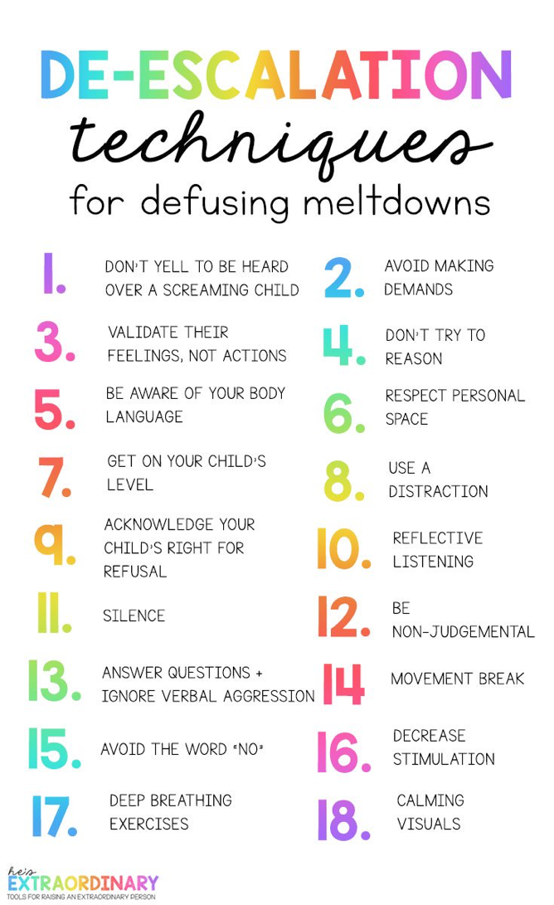
De-escalation techniques

Slide 17
Calming down techniques for anxiety and anger
Drink water
Sing
Hugging
Visualisation of happy memory
Colour in a book
Have a walk or run
Play dough
Calming music
Breathing
Blowing up balloons or bubbles

Slide 18
What does this child’s meltdowns look like?
If you a child is having repeated difficulties at home, can you see a pattern for behavior and calming?
Could you draw a table with headings saying:
Triggers Behaviours shown Helpful Strategies Unhelpful Strategies
It might be by recording regularly you are able to reduce the number of meltdowns or be more able to act, intervene and distract quicker

Slide 19
Looking after yourself
When our children challenge us or have melt downs, it can leave us feeling stressed. Remember to take time for you, this will make you more able to take time for your children.
  Look at a photo of family/loved one
  Listen to some music, dance around the kitchen (with a cuppa)
  Read an affirmation
  Stop and breath
  Stretch
  Look at something which makes you laugh

Slide 20
A thought….
All children and parents need to be able to make mistakes so they can learn from them

