Slide 1

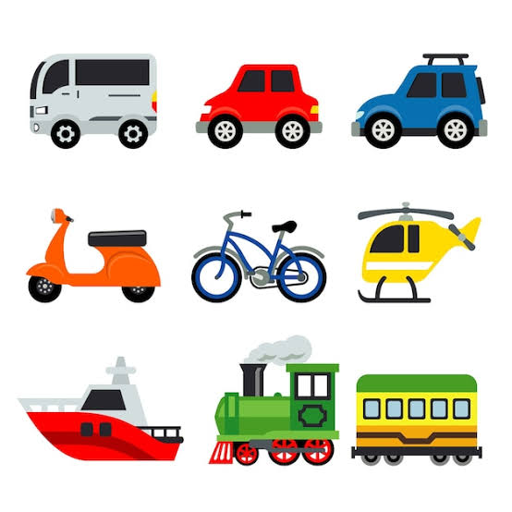
Communication and Language
- Be able to tell a long story
-Be able to express a point of view and debate
-Learn new vocabulary
-Develop social phrases
-Engage in story times
-Engage in non-fiction books
-Use talk to help work out problems and organise thinking
Physical Development
-Use and remember sequences related to music and rhythm
-Match their developing physical skills to tasks and activities
-Be increasingly independent as they get dressed
-Roll, crawl, walk, jump, run, skip, hop, climb
-Develop small motor skills to use a range of tools
Personal, Social and Emotional
-Develop their sense of responsibility and community
-Find solutions to conflicts and rivalries
-Develop appropriate ways of being assertive
-Talk with others to solve conflicts
-See themselves as a valuable individual
-Manage their own personal hygiene
Literacy
-Name the parts of a book
-Spot and suggest rhymes
-Count or clap syllables in a word
-Engage in extended conversations about stories
-Use some print and letter knowledge in early writing
-Blend sounds into words
Understanding the World
--Show interest in different occupations
-Explore how things work
-Develop positive attitudes about differences between people
-Understand the effects of the changing seasons
All Aboard!
Expressive Arts and Design
-Begin to develop complex stories using small world
-Explore different materials freely, to develop their imagination
-Draw with increasing complexity and detail
-Explore colour and colour mixing
-Respond to what they have heard, expressing -Play instruments with increasing control
Mathematics
-Solve real world mathematical problems to 5
-Talk about and explore 2D and 3D shapes and their features
--Discuss routes and locations
-Make comparisons relating to size, length, weight, capacity

